Slide 1
Daily Routines that Include Nutrition
August 2023

Slide 2
Creative Play
Daily Routines
Meal Transitions
Meal Service

Slide 3
Nutrition can be taught in many ways:
Using literature is always a good way to teach nutrition. There are many books about food, health and good nutrition
Creative play in the kitchen is also an excellent way to teach and reinforce good eating
Consider removing the “junk food” from your play kitchens and adding more fruits and vegetables
Go grocery shopping in your classroom with pretend foods
Include posters on the wall about MyPlate and healthy food choices
Incorporate cooking activities
Teaching Nutrition

Slide 4
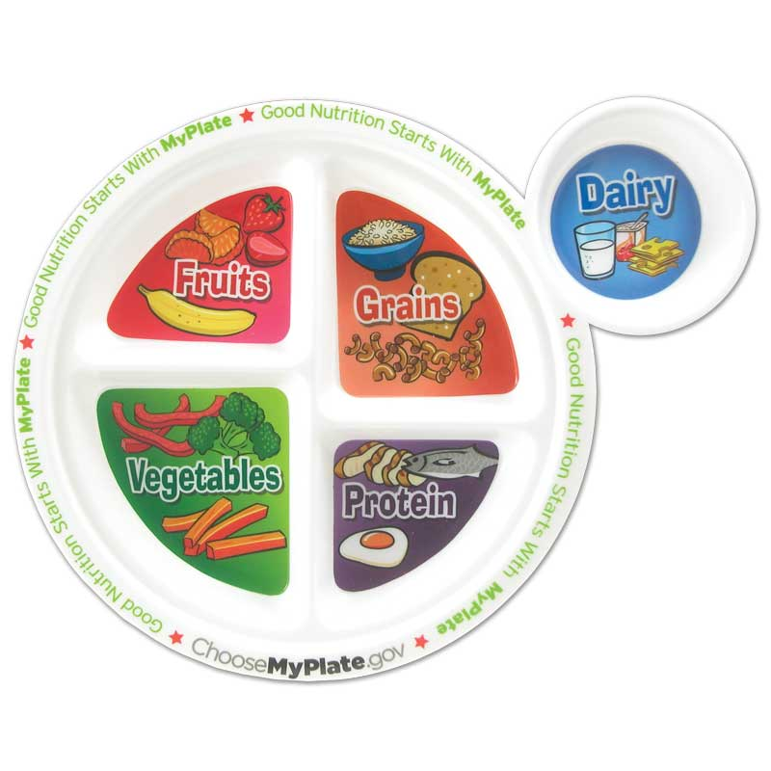
MyPlate
MyPlate is sponsored by the USDA and offers an excellent tool to teach about good nutrition

Slide 5

Cooking Activities
When using cooking activities to teach about nutrition, be sure to make nutritious foods
Don’t make things that contain a lot of sugar
Instead, make a fruit salad, smoothie, tossed salad, rice cake pizzas, etc.
Always use child friendly utensils
Always promote good food safety
Notes:
note applesauce can be made without sugar

Slide 6

Meal Transitions
It is important that children are ready to eat when the meal is served
Find an activity to help them to calm down before a meal
Have children wash hands and sit at the table
If you are serving a meal, tell them about the food that they are going to be eating
Ask them which food is the fruit, which the vegetable, etc.

Slide 7

Meal Service
Serving meals family style has advantages for both children and child care providers
Using family style meal service means that all foods are presented at the same time and passed around the table
Children are encouraged, but not forced, to put a portion of each food on their plates
Staff are encouraged to sit with the children and eat in child-size portions to model good eating and good table manners

Slide 8

Meal Service
Children should be provided adequate time to eat: it is recommended to allow 20 minutes for breakfast and snack and 30 minutes for lunch
Mealtime should include a meaningful conversation
Mealtime should not be a time for discipline
Food should not be used as a reward or withheld as a form of punishment

Slide 9

Meal Service
Children can assist with the meal service by:
  Helping to set the table
  Carrying foods to the table
  Serving themselves
  Cleaning up after the meal
Children should be taught about food safety by:
  Not eating off another person’s plate
  Using utensils to serve food and eat
  Not putting their utensils in the common dish

Slide 10
Resources and References
Caring for Our Children National Standards. Chapter 4 Nutrition and Food Service. https://nrckids.org/CFOC/Database/4 (specifically, 4.5 Meal Service, Seating, and Supervision; 4.7 Nutrition Learning Experiences for Children and Nutrition Education for Parents/Guardians.)
Institute of Child Nutrition. May 2022 Mealtime Memo: Nutrition Education for Young Children: https://theicn.org/mealtime-memo/may-2022
Institute of Child Nutrition. July 2022 Mealtime Memo: Family Engagement, Role Models of Healthy Behaviors: https://theicn.org/may-2022-mealtime-memo-nutrition-education-for-young-children-4/
Department of Defense Child Development Virtual Laboratory School. Essentials in Child Care Food Service: https://www.virtuallabschool.org/focused-topics/essentials-in-child-care-food-service
U.S. Department of Agriculture. MyPlate. https://www.myplate.gov/
Ellyn Satter Institute. https://www.ellynsatterinstitute.org/
Better Kid Care. Picky Eaters: A Guide to Responsive Feeding. https://extension.psu.edu/programs/betterkidcare/lessons/picky-eaters-a-guide-to-responsive-feeding
For more information on CACFP requirements please visit: https://portal.ct.gov/SDE/Nutrition/CACFP-Child-Care-Centers. Before implementing any changes to your program’s food and nutrition policies or practices, contact your CACFP representative to ensure you are meeting all rules and regulations.
Disclosure: The information in this module is based on a variety of sources listed above. It highlights key points relevant to this topic, but is not exhaustive. Please refer to the above resources for more information.

Slide 11


Thank You!
Made possible with funding from
the Centers for Disease Control and Prevention

