Slide 1
Food Safety in
Childcare
August 2023
Notes:
Welcome to Food Safety in Childcare. This brief module is offered as a complement to Early Care and Education college courses that cover health, safety and nutrition. It is not meant to be exhaustive but simply highlight important best practices and key information as well as provide you with additional resources.
Safe food practices are very important in child care because young children are at higher risk of choking and getting very sick from food borne illnesses.

Slide 2
Practice Food Safety When Feeding Young Children by Following These Strategies:
Offer finger foods such as small pieces of banana and foods that have been well-cooked and finely cut up
Always watch young children while they are eating
Encourage children to take their time while eating and to chew well
Make meal and snack periods a time for sitting down - do not allow children to lie down or run and play while eating and drinking
Read labeling on packages. Foods with high choking risks often have warning labels
First aid and CPR may be required if the child is choking; be prepared to act quickly
Notes:
Let’s start by looking at ways you can help prevent choking. These strategies are detailed in Caring for Our Children: National Health and Safety Performance Standards which is linked in the resources at the end of this presentation.
Especially for young children who might just be learning to eat solid foods, offering small pieces of soft foods that they can pick up themselves is a great way to both support their eating exploration and to help prevent choking. Remember that young children’s throats are quite small. This is why you want to cut foods to an appropriate size when preparing meals and snacks. For infants, foods should be cut to a quarter inch or smaller and for toddlers foods should be cut to a half inch or smaller.
Young children also tend to be active and easily distracted. When you sit with children to eat during meals and snacks, there are multiple benefits across developmental domains. By sitting with children, engaging them in conversation and actively observing their actions, you are able to help them slow down, stay focused on eating and see any signs of choking right away. This level of connection and language development are also beneficial for children’s social and emotional development.

Slide 3
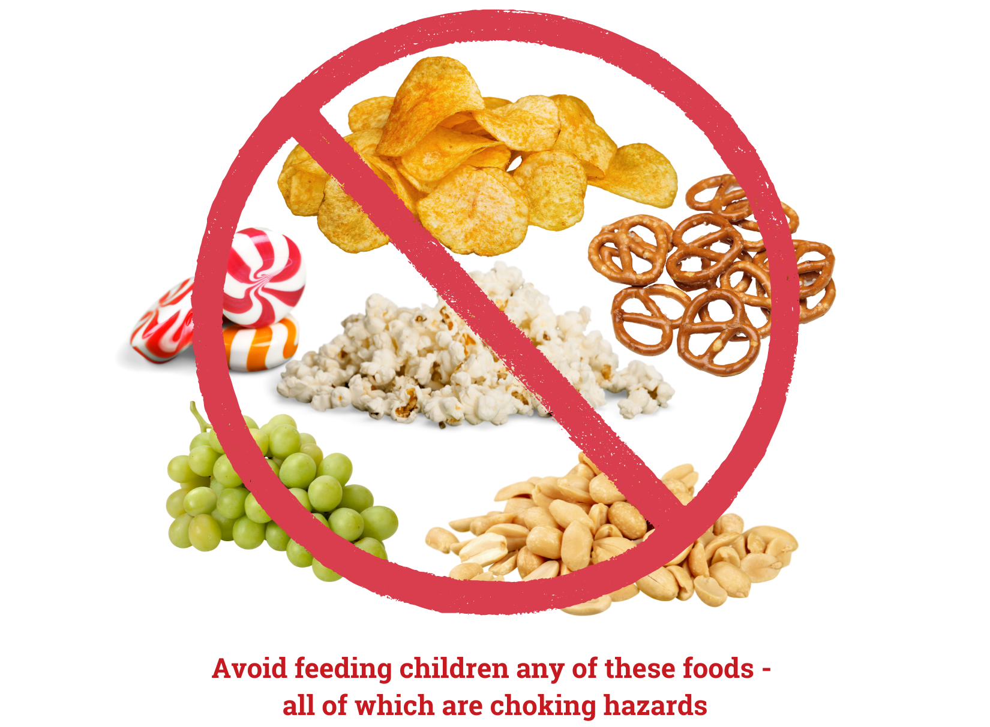
Notes:
There are also some food textures and consistencies that are more likely to cause choking in young children. Caring for Our Children standards describe these as round, hard, small, thick and sticky, smooth, compressible or dense, or slippery. And of course the most common foods children choke on are foods they tend to eat more often. These are also listed in Caring for Our Children and include hot dogs and other meat sticks (either whole or sliced into rounds), raw carrot rounds, whole grapes, hard candy, nuts, seeds, raw peas, hard pretzels, chips, peanuts, popcorn, rice cakes, marshmallows, spoonsful of peanut butter, and chunks of meat larger than can be swallowed whole. When planning meals and snacks, it’s a good idea to avoid these items even if the children like to eat them.

Slide 4
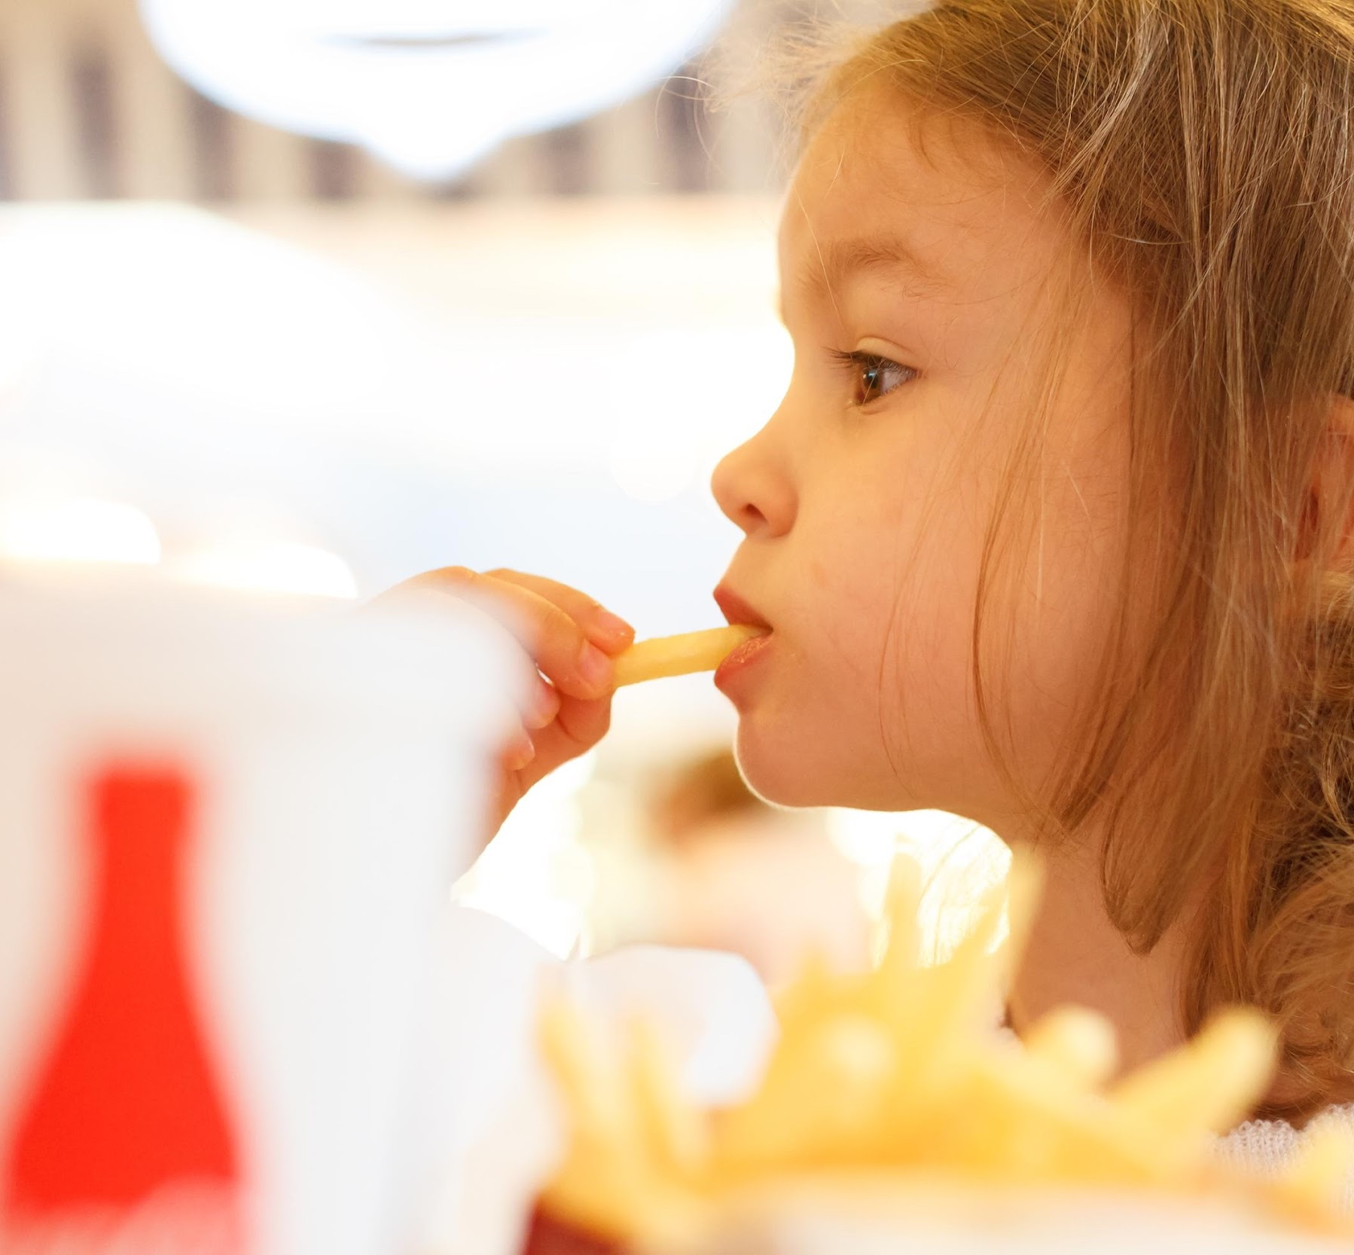
Foodborne Illness
Young children are at high risk for foodborne illness.
Because young children do not have fully developed immune systems, they are more susceptible to getting sick from food that is not handled or cooked properly.
Notes:
Let’s move on to Foodborne Illnesses which occur when someone eats a food or beverage that is contaminated, either by a microorganism such as a bacteria or by a non-food chemical. Young children are at a higher risk for becoming very sick from contaminated foods and drinks because their immune systems are still developing, it’s harder for them to fight infections. They also produce less stomach acid than older people so that first line of defense that can kill off some pathogens, is not as strong in young children as in older people.

Slide 5
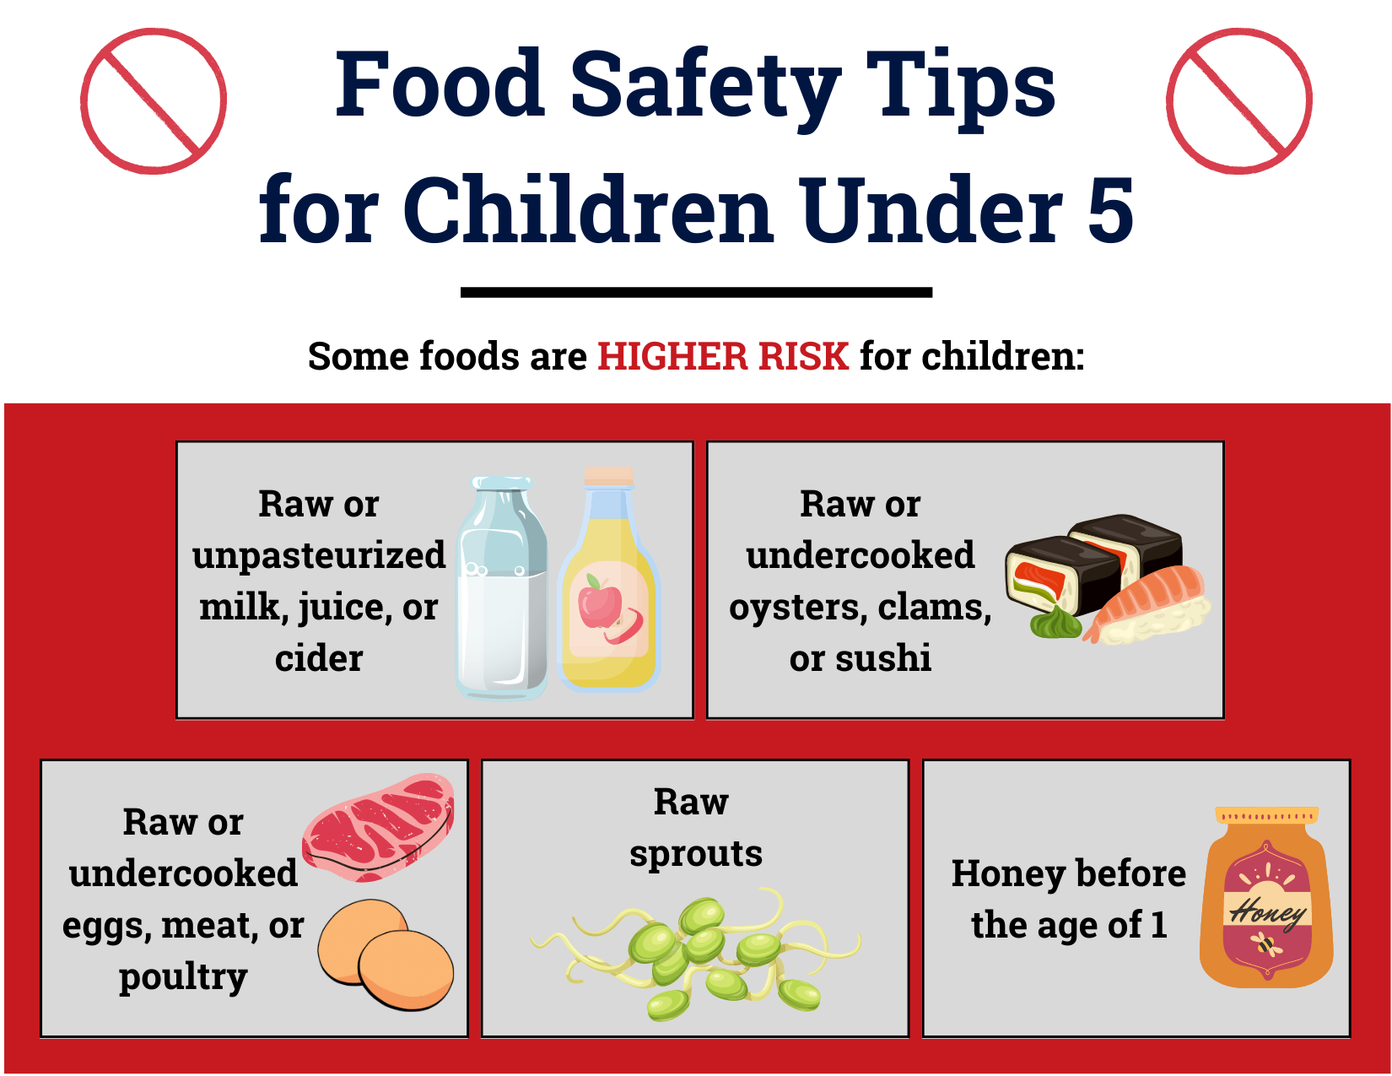
Notes:
Just as there are some foods more likely to cause choking, there are some foods that are more likely to contain bacteria or other harmful pathogens that really need to be handled carefully to avoid foodborne illnesses, especially for young children. Avoid any milk or juice that is raw or unpasteurized, as well as raw or undercooked fish, shellfish, meat, eggs or poultry and raw sprouts. And for infants under age 1, honey should be avoided because it may have the bacteria clostridium which can cause botulism in babies. Older children and adults are not affected.
As a side note, in case you were wondering, pasteurization is the process of heating a food or beverage just high enough to kill off any pathogens but not so high that it is completely cooked

Slide 6
Types of Cross-Contamination
Hand-to-Food
Food-to-Food
Chemical Contamination
Equipment or Food Contact Surfaces-to-Food
Notes:
There are four types of cross-contamination which are the main ways that harmful pathogens or chemicals can accidentally get into food. Refer to the Child Care Center Food Safety Guide linked in the resources for more details on each of these situations and how to prevent cross contamination.
Hand-to-food is when a person has something on their hands, whether they are wearing gloves or not, and it gets into the food they are preparing or serving. Proper handwashing throughout the day and especially prior to handling food or eating with the children is really important. And remember to remove or change your gloves between tasks. For details on proper handwashing, please review the Caring for Our Children standards.
Food-to-food contamination happens when the pathogen in one food is spread to other foods. This could happen in the refrigerator if raw chicken or meat is on a shelf above ready to eat fruit and the juice from the meat leaks onto the fruit. Always store ready to eat foods separate and in the refrigerator they should be up above foods that need to be washed or cooked.
Equipment or Surface-to-food contamination happens when a cutting board, counter, can opener or other preparation or storage surface is not cleaned between uses and the germs get passed from food to food that contact that surface.
And finally chemical contamination can happen if any chemicals, including cleaning and sanitizing solutions get on a food that is eaten. Store chemicals safely out of reach and out of the food preparation and eating areas.

Slide 7
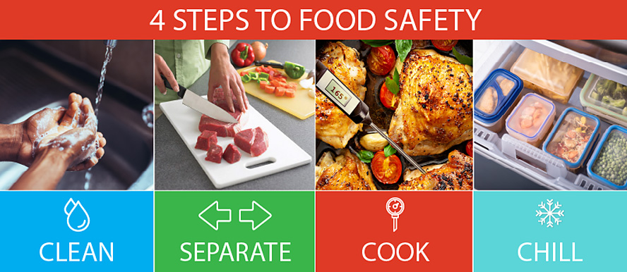
https://www.cdc.gov/foodsafety/keep-food-safe.html
Notes:
The Center for Disease Control and Prevention along with the Food and Drug Administration offers this advice to help prevent foodborne illnesses: Clean, Separate, Cook and Chill. Clean your hands, surfaces, food storage areas and equipment properly; separate prepared and ready to eat foods from those that need to be cooked or cleaned; Cook foods to the proper internal temperature and store foods in the refrigerator or freezer, don’t leave them out at room temperature

Slide 8
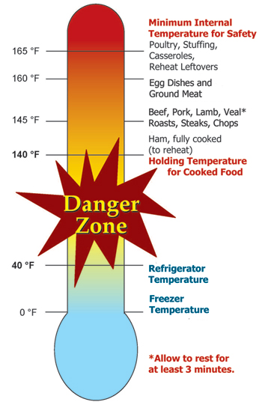
Keep Food
Out of the “Danger Zone”
Source: USDA Food and Safety Inspection Service https://www.fsis.usda.gov/food-safety/safe-food-handling-and-preparation/food-safety-basics/danger-zone-40f-140f
Notes:
Which brings us to the temperature danger zone for perishable foods which is 40 to 140 degrees Fahrenheit. You need to keep your hot foods hot and your cold foods cold because anytime a food is held in this temperature range, any bacteria or other germs that happen to be in or on that food, multiply exponentially. That means in a few minutes one bacteria can turn into hundreds. Any perishable foods, things like meat, seafood, dairy, cut fruit, some vegetables and cooked leftovers, that are kept out at room temperature, in this danger zone, for more than 2 hours, need to be thrown out. And if the food is out in temperatures above 90 degrees, such as at a picnic or in the car, should be thrown out after only one hour.

Slide 9
Storage Temperatures
Dry Goods:
50-70°F
Refrigerator:
40°F or Below
Freezer:
0°F
Chemical:
No Specific Temp
*Keep chemicals stored away from the food - Mark chemicals if changing containers
Notes:
Again, temperature is important for controlling harmful pathogens and pests.
Dry goods should be kept cool between 50 and 70 degrees and at least 6 inches off the floor. The refrigerator should be kept at 40 degrees or below and the freezer at 0. It’s helpful to keep thermometers in the storage areas so you can monitor these temperatures. While chemicals don’t need a specific temperature it’s good practice to keep them in a separate area and well-marked so they don’t accidentally end up in the food.

Slide 10
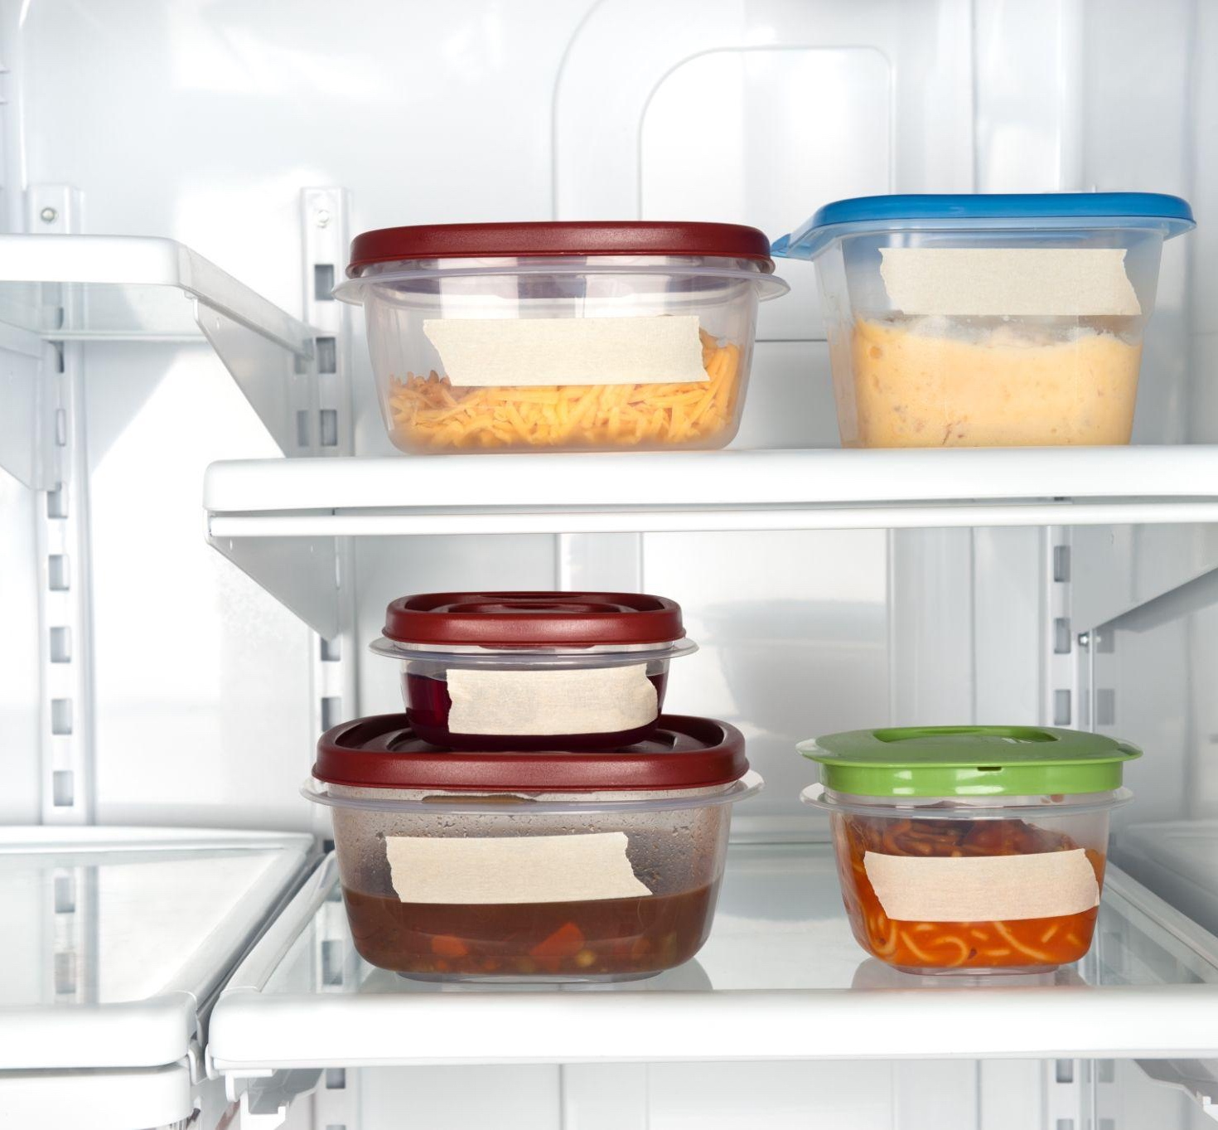
Leftovers
Any food that was served individually or in family style bowls, plate or pitchers should be discarded after the meal
Unserved food should be covered and refrigerated and then be used within 24 hours
You may place hot food directly in the refrigerator or cool them in an ice bath if very hot (items such as soup or stew). Once they cool down, cover them
Any prepared foods that have been left out for 2 hours or more should be discarded
Notes:
No one likes to waste food, especially not when budgets are tight. Good food preparation and handling practices can help you prevent making anyone sick while still being able to utilize leftovers. Keep in mind that any foods that have been served, whether it’s on a child’s plate or passed around family style, needs to be thrown out after the meal. Germs are easily passed and food is easily contaminated at the table, especially with young children. If you have any unserved food , that is any food that has not left the kitchen, it can be stored in the refrigerator for use within the next 24 hours. It’s a good idea to refrigerate foods quickly, even if they are still hot. Any foods left out for 2 hours or more should be thrown away as mentioned previously.

Slide 11

Cleaning and Sanitizing
5 steps to cleaning and sanitizing counters and eating surfaces
Remove any visible dirt
Wash the surface with soapy water
Rinse the surface with clean water
Apply sanitizer
Allow to air dry
Notes:
No food safety presentation would be complete without reviewing cleaning and sanitizing. Surfaces should be cleaned prior to sanitizing in order for the sanitizing to be most effective. Once clean, apply the sanitizer of choice and allow to air dry. Please refer to Caring for Our Children and your State licensing information for the types of sanitizers that are allowed.

Slide 12
Resources and References
Caring for Our Children National Standards. Chapter 4: Nutrition and Food Service. 4.9. Food Safety: https://nrckids.org/CFOC/Database/4.9.0
Institute of Child Nutrition. The Child Care Center Food Safety Guide, 2022: https://theicn.org/icn-resources-a-z/food-safety/
CDC’s Four Steps to Food Safety: https://www.cdc.gov/foodsafety/keep-food-safe.html
Nemours, KidsHealth, Food Safety: https://kidshealth.org/en/parents/food-safety.html
Department of Defense Child Development Virtual Laboratory School. Essentials in Child Care Food Service: https://www.virtuallabschool.org/focused-topics/essentials-in-child-care-food-service
US Department of Health and Human Services, FoodSafety.gov. People at Risk: Children Under Five: https://www.foodsafety.gov/people-at-risk/children-under-five
Disclosure: The information in this module is based on a variety of sources listed above. It highlights key points relevant to this topic, but is not exhaustive. Please refer to the above resources for more information.
Notes:
As with each module, we encourage you to review these resources as they contain more details and information to help you keep food safe and prevent food borne illnesses.

Slide 13


Thank You!
Made possible with funding from
the Centers for Disease Control and Prevention
Notes:
Thank you for joining us to review Food Safety. This module is made possible by the Centers for Disease Control and Prevention and was developed in collaboration between the UConn Rudd Center for Food Policy and Health and the CT Department of Public Health.

