Slide 1
Food Allergies
August 2023
Notes:
Welcome to Food Allergies. This brief module is offered as a complement to Early Care and Education college courses that cover health, safety and nutrition. It is not meant to be exhaustive but simply highlight important best practices and key information as well as provide you with additional resources.

Slide 2

Food Allergies in Young Children
Understanding food allergies and intolerances
Allergy management
Common food allergies
Signs and symptoms of food allergies
Notes:
Knowing the ins and outs of food allergies and intolerances is important for the health and safety of young children in your care. In this module we’ll review the differences between preferences, intolerances and allergies. We’ll also cover important strategies for managing food allergies and supporting children in your care so they can stay safe.

Slide 3

What is a Food Allergy?
A food allergy occurs when the body identifies a certain food as harmful and overreacts by causing symptoms
The protein in the food triggers this reactions
Food intolerance involves the digestive system, while food allergies involve the immune system
Notes:
I’m sure you’re at least a little bit familiar with food allergies. Like other kinds of allergies, they occur because the body is mistakenly reacting to a protein in the food as if it were a virus or a bacteria or some other harmful invader. This is an over-reaction by the immune system and in some cases it can be life threatening. By contrast, a food intolerance involves the digestive system. So even though both involve food, they are completely different systems in the body that cause the reaction and thus the symptoms and experiences are quite different.

Slide 4
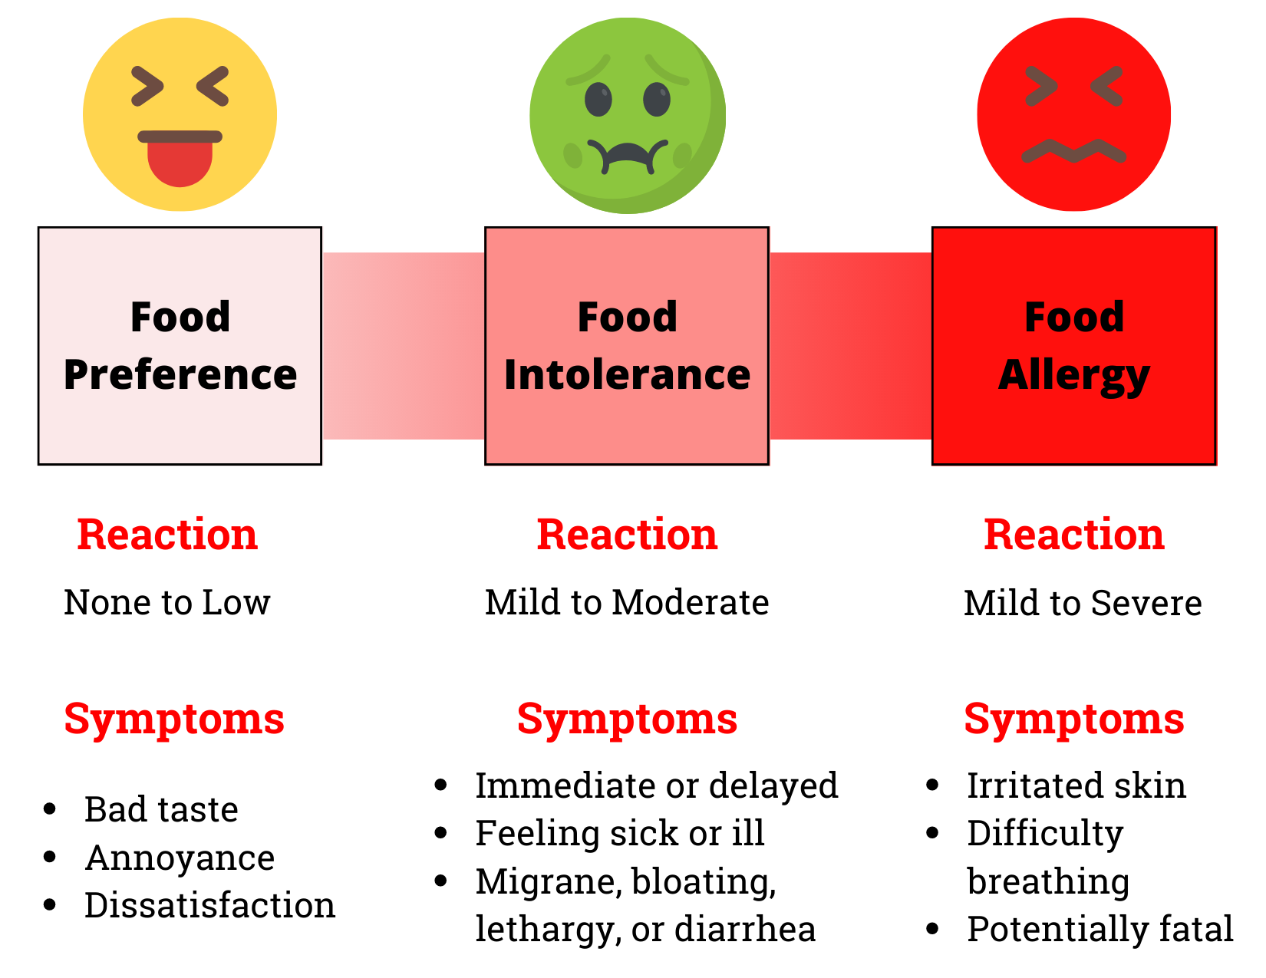
Notes:
Let’s look a little closer at the differences between preferences, intolerances and allergies. While each of these conditions is important to plan for and manage in your child care setting, it’s only food allergies that can be life threatening. Because of that, we’ll spend most of this module covering how to manage food allergies.
Supporting children in learning to try and accept new foods is the best way to manage food preferences and ultimately food choices. While it’s important to trust that children know what foods they like and what foods they don’t like, it’s also possible to help them become more relaxed and adventurous eaters.
Food intolerances occur when a person is not able to digest a certain food or component of a food. For example, lactose intolerance is when a person is unable to digest lactose, the naturally occurring sugar in dairy products. It can lead to unpleasant symptoms such as stomach bloating and diarrhea. Food intolerances are not life threatening in the short term but still require careful management to keep the child healthy.
Food allergies, as I stated previously, are an immune system response and can range from mild to life-threatening. Let’s go over the basics of how to care for children with allergies.

Slide 5
Allergy Management
Always ask for medical documentation for a child with food allergies
Some children may only be sensitive to small amounts of the food, while others need to avoid it completely
Providing the allergy-free food is very important for the child
A severe reaction may lead to anaphylaxis (closing of the airways)
Many children with severe food allergies will require an epinephrine auto-injector (Epi-pen) to be kept on hand in case of accidentally eating the food and if anaphylaxis should occur
Notes:
The first step is to ask the child’s family to provide documentation from their doctor, which is sometimes called a care plan, so you are clear on the type and severity of the child’s allergy as well as the recommended treatment. Children’s allergic responses can vary widely. It’s possible that just being in the same room with an allergen can cause a reaction for some children while others may be able to eat the food if prepared in a certain way. The doctor’s care plan can help clarify what needs to be done to keep the child safe.
In some cases, the child may need to have an Epi pen or other rescue medication on site to reverse a severe airway reaction called anaphylaxis.

Slide 6
More on Food Allergies
People with one autoimmune disorder often have more than one, and since a food allergy is an autoimmune disorder, it is not uncommon for a child to be allergic to a few or even many foods
You will need to work with your dietitian to modify the menus to ensure the meals are safe for all children to eat
If the source of the allergy is unknown, an elimination diet may be needed, but this would be guided by the child’s doctor
Notes:
It’s common for a person to be allergic to multiple foods or environmental allergens. This can be a little overwhelming when trying to prepare meals and snacks. Luckily, you don’t have to figure everything out on your own. Your Dietitian consultant can help you create menus, read labels and approve foods to serve in your program that are safe for all children.
Because you are working with young children, you may have a child in your care who develops allergic symptoms but does not yet have a diagnosed allergy. You may be asked to by the child’s family to help them with an elimination diet prescribed by the child’s doctor to help determine if foods are the cause of the allergy. Elimination diets may also be used to help determine a food intolerance. Also, if you notice a child exhibiting some of the symptoms of an allergic reaction, whether they are diagnosed or not, follow your emergency protocols, including calling 9-1-1 if needed.

Slide 7
More on Food Allergies
When children with food allergies attend an early care and education facility, here is what should occur:
“Each child with a food allergy should have a care plan prepared for the facility by the child’s primary health care provider, to include allergy, food to avoid and medications required”
“Based on the child’s care plan, the child’s caregivers/teachers should receive training, demonstrate competence in, and implement measures”
“Parents/guardians and staff should arrange for the facility to have the necessary medications, proper storage of such medications, and the equipment and training to manage the child’s food allergy while the child is at the early care and education facility”
“Caregivers/teachers should promptly and properly administer prescribed medications in the event of an allergic reaction according to the instructions in the care plan”
4.2.0.10: Care for Children with Food Allergies https://nrckids.org/CFOC/Database/4.2.0.10
Notes:
As with all of the topics covered in this series, Caring for Our Children: National Health and Safety Performance Standards; Guidelines for Early Care and Education Programs is an excellent resource. The steps outlined here come directly from Caring for Our Children and the link is in the resource list. Refer back to these steps as often as necessary and reference them in your policy to ensure you have good practices around managing allergies of all kinds.

Slide 8
More on Food Allergies
“The facility should notify parents/guardians immediately of any suspected allergic reactions, the ingestion of the problem food, or contact with the problem food, even if a reaction did not occur”
“The facility should recommend to the family that the child’s primary health care provider be notified if the child has required treatment by the facility for a food allergic reaction”
“The facility should contact the emergency medical services (EMS) system immediately if the child has any serious allergic reaction and/or whenever epinephrine (eg, EpiPen, EpiPen Jr) has been administered, even if the child appears to have recovered from the allergic reaction”
“Parents/guardians of all children in the child’s class should be advised to avoid any known allergens in class treats or special foods brought into the early care and education setting”
“Individual child’s food allergies should be posted prominently in the classroom where staff can view them and/or wherever food is served”
4.2.0.10: Care for Children with Food Allergies https://nrckids.org/CFOC/Database/4.2.0.10
Notes:
The recommendations from Caring for our children are continued on this slide. You can use these steps to help inform your emergency protocols as well.

Slide 9
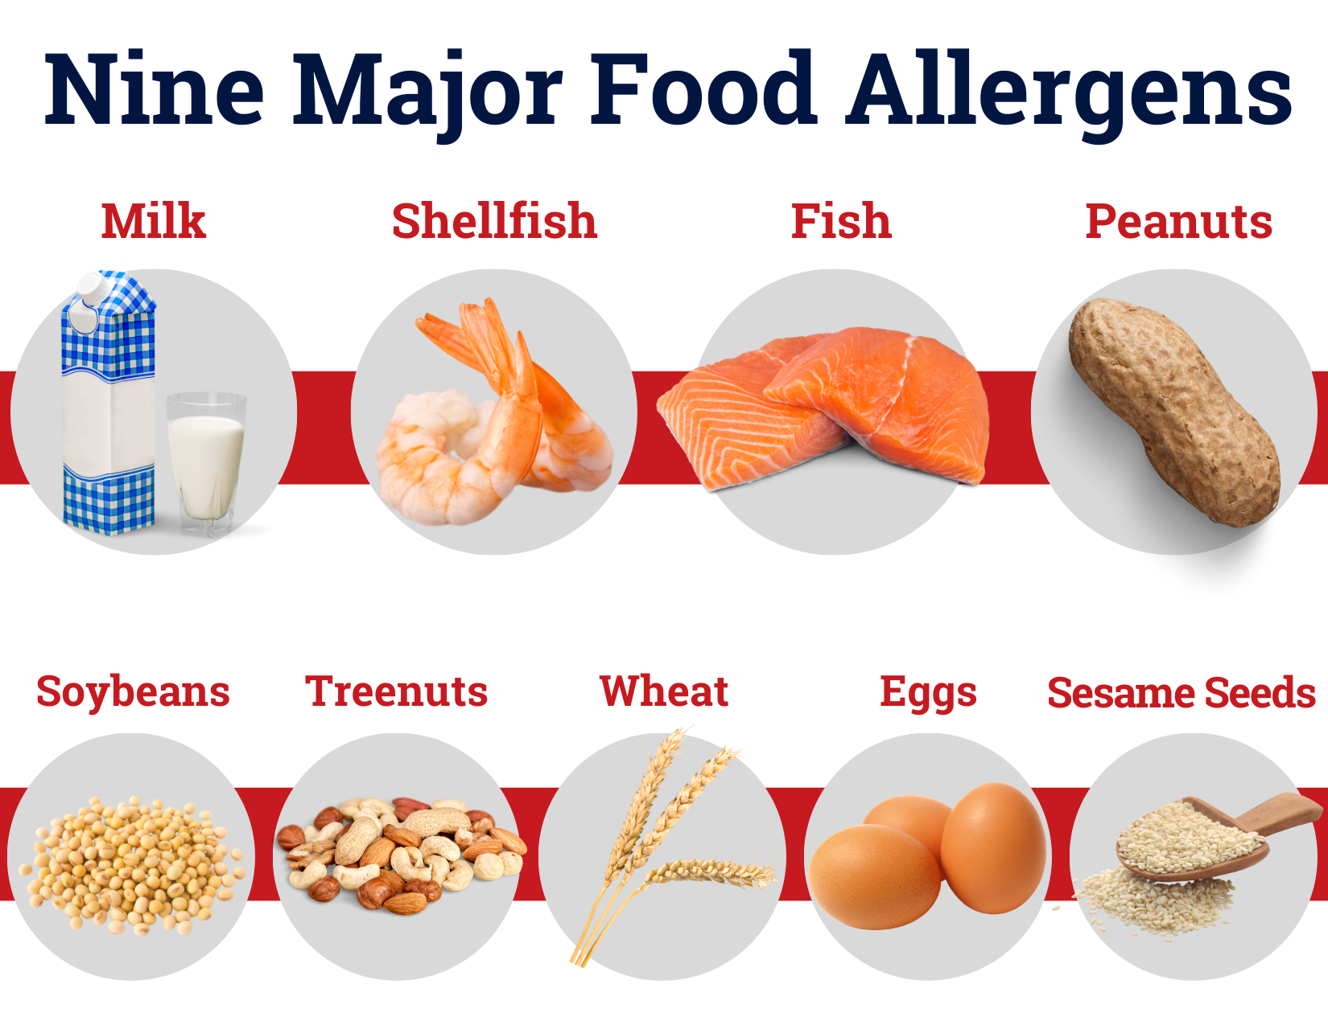
Notes:
A person can be allergic to any food but there are some that are much more common than others. According to the U.S. Food & Drug Administration, Milk, Shellfish, Fish, Soy or soybeans, peanuts, treenuts, eggs, wheat and sesame seeds are the most common allergens.

Slide 10
Food Allergy Facts
Fact 1
7.6% of children have food allergies
Fact 2
Milk, egg, wheat, and soy allergies are often outgrown. Most people do not outgrow peanut, tree nut, fish, and shellfish allergies
Fact 3
Children with food allergies are 2-4 times more likely to have asthma or other allergic diseases
Notes:
Some quick facts about allergies, almost 1 in 12 children have food allergies. Some of them will outgrow the allergy, particularly if it’s a milk, egg, wheat or soy allergy and children with food allergies are much more likely to have asthma or other non-food allergies .

Slide 11
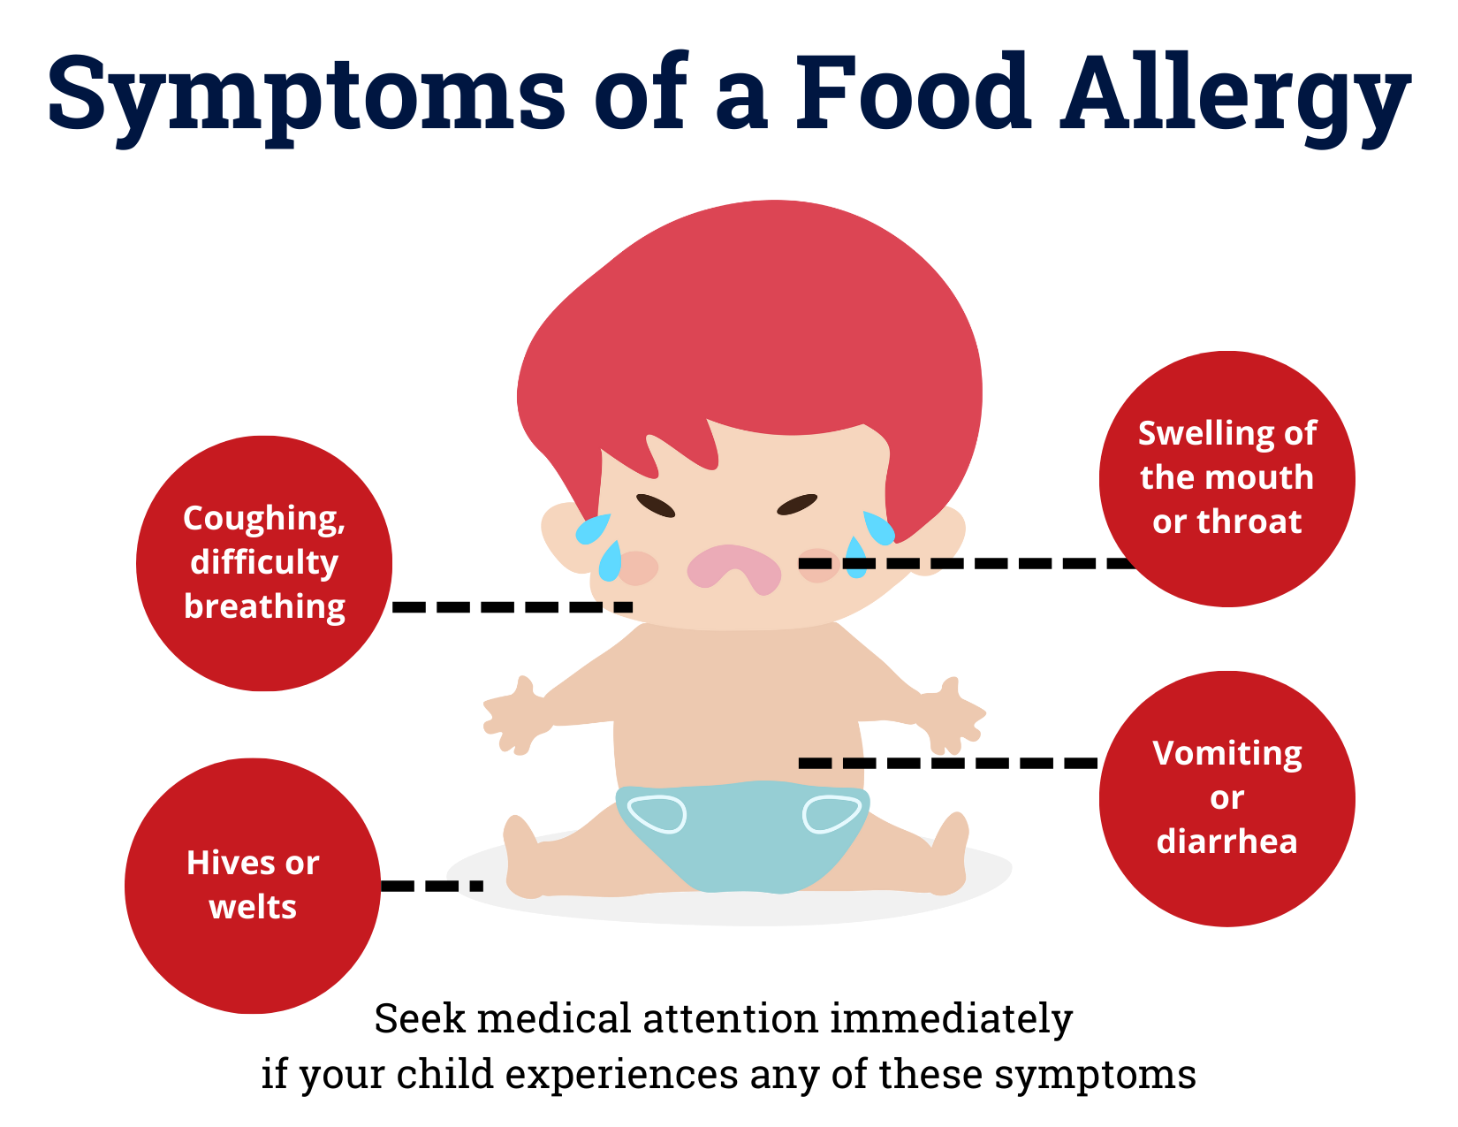
Notes:
It’s important to know and recognize the symptoms of an allergic reaction so you can seek medical attention quickly. Coughing, difficulty breathing, swelling in the mouth or throat, hives and vomiting or diarrhea are all symptoms to watch out for.
Again, if you notice symptoms, enact your emergency protocols, including calling 9-1-1 if needed.

Slide 12
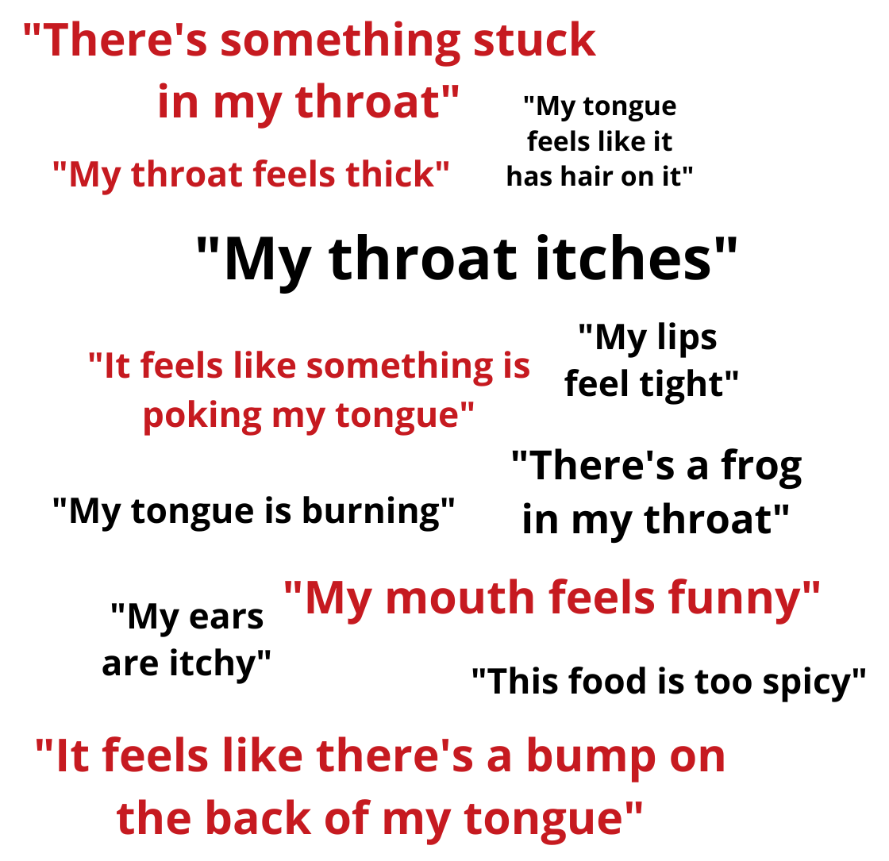
Young children may not know that what they are feeling is a food allergy reaction.
Instead, they may say any of the following:
Notes:
And, because children may not have been diagnosed yet or may not have a good understanding of what their allergy is, watch for these words or phrases that children may use to convey symptoms of an allergic reaction. Recognizing these phrases will help you act quickly

Slide 13
Resources and References
Caring for Our Children National Standards Chapter 4: Nutrition and Food Service. 4.2. General Requirements. 4.2.0.10: Care for Children with Food Allergies https://nrckids.org/CFOC/Database/4.2.0.10
Institute of Child Nutrition, Mealtime Memo September 2022 – Food Allergies and Intolerances: https://theicn.org/september-2022
Institute of Child Nutrition, Child Care Center Food Allergy Fact Sheets: https://theicn.org/icn-resources-a-z/child-care-center-food-allergy-fact-sheets
Department of Defense Child Development Virtual Laboratory School. Essentials in Child Care Food Service: https://www.virtuallabschool.org/focused-topics/essentials-in-child-care-food-service
Asthma and Foundation of America, Kids With Food Allergies: Kidswithfoodallergies.org
Disclosure: The information in this module is based on a variety of sources listed above. It highlights key points relevant to this topic, but is not exhaustive. Please refer to the above resources for more information.
Notes:
As with each module, we encourage you to review these resources as they contain more details and information to help you provide high quality care for children with food allergies.

Slide 14


Thank You!
Made possible with funding from
the Centers for Disease Control and Prevention
Notes:
Thank you for joining us to review Food Allergies. This module is made possible by the Centers for Disease Control and Prevention and was developed in collaboration between the UConn Rudd Center for Food Policy and Health and the CT Department of Public Health.

