Slide 1
Feeding Children with Special Needs
August 2023
Notes:
Hi, thanks for joining me today for Feeding Children with Special Needs. This brief module is offered as a complement to Early Care and Education college courses that cover health, safety and nutrition. It is not meant to be exhaustive but simply highlight important best practices and key information as well as provide you with additional resources.

Slide 2
Children with Special Dietary Needs
Children with Autism Spectrum Disorder
Adaptive Equipment
Medical Diets
Notes:
There are many situations where a child might need a modification in the foods they are fed or the manner they are fed. In this module we will review children with Autism Spectrum Disorder or ASD knowing that many of the adaptations that support their needs can also be helpful for other children, with or without a formal diagnosis. We will also touch on adaptive equipment that may be useful to consider and medical diets to help you prepare for an experience with a child who needs greater dietary modifications. As with every child in your care, we encourage you to see the child first, celebrate their unique qualities and create opportunities for their individual growth and development.

Slide 3
Children with Autism Spectrum Disorder
Many children with autism have food dislikes and sensitivities
Many will only choose certain textures or colors of food
They may become undernourished if whole food groups are avoided
Children with autism may have trouble focusing on the meal and not finish the food provided
Constipation is often a problem due to dietary choices
Medication reactions: some autism medications cause a decrease in appetite
Notes:
Children with Autism Spectrum Disorder, ASD, may have very mild to very severe sensitivities to food texture, appearance or taste, just as they might be sensitive in other areas of the classroom. They may also have side effects to medication that can cause changes to their appetite. Because they may be unable to tolerate some foods or even whole food groups, they are at risk for developing nutritional deficiencies that can impair their health. As a child care provider your role in supporting children with ASD, or any neurodivergence, is critical. Start by learning as much as you can about each individual child’s current capabilities and work with their family and health providers to determine what expectations they have for the child while in your care. Every child with ASD is unique and will need an individual approach. Work with their family and health professionals to ensure each child’s feeding plan meets their nutritional needs as well as their sensitivities.

Slide 4
For Children with Autism Spectrum Disorder
Create a consistent meal time and routine
Keep the meal service area simple and avoid distractions
Offering a choice to a child with autism may help them to accept the food more readily
Do not serve foods that may trigger a reaction and cause a quick end to the meal
Keeping food separated using a divided plate may help
Notes:
There are some basic things that are likely to be helpful for children with ASD that may also be helpful to other children in your care. Many children benefit from a consistent schedule with predictable and supportive transitions. Offering choices, keeping the interactions supportive and keeping your energy relaxed and ready, can help the child to stay calm as well. The child’s family and health care team may offer suggestions like using divided plates or other mealtime supplies that can help.

Slide 5
How to Help
Work with the child’s parents and health care team
Create a plan that will make the child comfortable at mealtimes
Be flexible, the plan may change
Have patience
Notes:
Most importantly, create lots of opportunities for two-way communication with the child’s family, and when you have permission, also with the child’s health care team. They will give you lots of clues about the situations and strategies that are most beneficial for the child as well as key stressors or triggers. The child’s health care team will also be able to offer strategies and support for your setting that might be new or different from what the child has experienced previously. Your partnership and patience will help children with ASD continue to engage and make progress at mealtime.
Just as you would be flexible and supportive with a child as they are learning to explore at the texture table, being flexible and supportive at mealtimes promotes children’s emotional regulation, including children with ASD. What strategies can you adopt that will help you remain calm so you can in turn support the children? Use the child’s strengths as a starting place and limit the things that may add to their stress or overwhelm. Again, have patience and recognize where you can be even more flexible.

Slide 6
Adaptive Equipment
Some children may need adaptive equipment to assist in eating
Adapted feeding equipment or tools are used to help children with feeding problems and to increase independence, as well as to help children to feel “normal.” These tools include cups, plates, and utensils
These children often work with an occupational therapist who will assist you with the type of equipment that is needed
Notes:
In addition to children with ASD, you may have children with other types of differences in your care. For some kids who have fine or gross motor delays or other types of musculoskeletal impairments, adaptive plates, bowls, cups and utensils may be used as part of their therapeutic treatment plan. Using these special tools supports children’s growth, their independence and eating success. You will likely be working with their family and an occupational therapist as part of their team. Provide clear and consistent two-way communication with the child’s family will help you create a mealtime experience that is stress-free and offers the child the opportunity to be nourished and experience growth

Slide 7
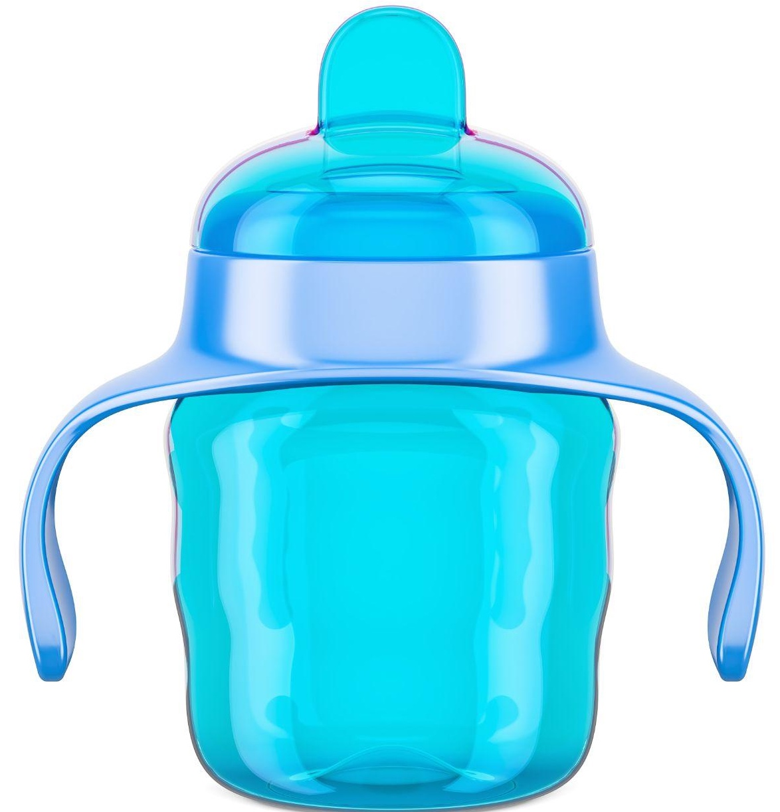
Equipment can be utensils with large or foam handles, suction bowls and plates, high rim plates, straws or cups with handles.
Notes:
Some examples of adaptive equipment include cups with an adaptive handle, forks or spoons with extra large grips or bowls that have a grip on the bottom. If you think a child might benefit from something like this, speak with their family about options.

Slide 8
Medical Diets
Children could have medical conditions that require a specialized diet, such as:
Diabetes
Celiac disease
Heart disease
Cystic fibrosis
Sickle cell anemia
Inborn errors of metabolism
Notes:
There are some health conditions for which special diets, sometimes called medical diets, are required to ensure the child is adequately nourished. Not all serious health conditions will require a major dietary modification but these listed are some that do. Sometimes the condition requires physical modification to the foods and sometimes specific foods are allowed or not allowed or the timing of meals could be modified.

Slide 9
Dietary Modifications
Caregivers/teachers should modify or supplement the child’s diet to meet the individual child’s specific medical or dietary needs
Parents/guardians and the child’s primary health care provider should consult to determine if dietary modifications should be made
Caregivers/teachers may consult with a Registered Dietitian for guidance on how best to meet the child’s needs
A care plan for each child should be created and shared
with staff in the kitchen and classroom
Notes:
Work closely with the child’s family, doctor, and other health care team members as well as your staff to ensure that any foods served meet the child’s required modifications. Your nurse consultant, Dietitian and the child’s family and health care team will be able to help you understand more about the child’s medical condition and how to support their dietary needs. It’s important to take these and any health conditions a child has, including allergies, very seriously as the child’s health can be at risk .

Slide 10
Resources and References
Caring for Our Children National Standards. Chapter 4: Nutrition and Food Service. 4.2. General Requirements/Feeding Plans and Dietary Modifications: https://nrckids.org/CFOC/Database/4.2.0
Connecticut State Department of Education. Accommodating Special Diets in CACFP Child Care Programs, April 2022: https://portal.ct.gov/-/media/SDE/Nutrition/CACFP/SpecDiet/Guide_Special_Diets_CACFP.pdf
USDA Food and Nutrition Service. Accommodating Children with Special Dietary Needs in School Nutrition Programs: https://fns-prod.azureedge.us/sites/default/files/special_dietary_needs.pdf
eXtension Alliance for Better Child Care. Accommodating Special Diets in Child Care: https://childcare.extension.org/accommodating-special-diets-in-child-care/
Disclosure: The information in this module is based on a variety of sources listed above. It highlights key points relevant to this topic, but is not exhaustive. Please refer to the above resources for more information
Notes:
These resources support the content covered in this brief module. We encourage you to take a look at them for more information and to share with families in your care.

Slide 11
Thank You!
Made possible with funding from
the Centers for Disease Control and Prevention
Notes:
Thank you for joining us to review Feeding Children with Special Needs. This module is made possible by the Centers for Disease Control and Prevention and was developed in collaboration between the UConn Rudd Center for Food Policy and Health and the CT Department of Public Health.

