Slide 1
Breast/Chestfeeding Friendly Child Care
August 2023​
Notes:
Welcome to Breast/Chestfeeding Friendly Child Care. This brief module is offered as a complement to Early Care and Education college courses that cover health, safety and nutrition. It is not meant to be exhaustive but simply highlight important best practices and key information as well as provide you with additional resources.
You may have noticed that we are using the term Chestfeeding. Later in the module we will also use the term human milk and human milk feeding. This updated language recognizes that the lactation field is moving toward more inclusive language to provide more inclusive support. Not all people identify with the term breastfeeding. Some people prefer chestfeeding, some prefer human milk feeding and some prefer breastfeeding. All are acceptable and we encourage you to ask the families you work with what terms they prefer. For more information on how to use these terms interchangeably, as we will do in this module, please see the Appendix, on page 71, in The Continuity of Care in Breastfeeding Support Blueprint, located in the resources at the end of this module. Let’s get started!

Slide 2
Why Support
Breast/Chest
Feeding?
Human milk-fed babies are sick less often*
fewer colds & ear infections, less diarrhea
protects against SIDS
Human milk is easier for baby to digest
babies spit up less & have less smelly diapers compared to formula-fed babies’
Financial benefit in CACFP
claim breast fed meals in in the CACFP, whether fed with bottle or by parent on site
*Pediatrics (2022) 150 (1): e2022057988.
Notes:
You may have heard some of the health benefits for babies when they are fed human milk, such as protecting them against Sudden Infant Death Syndrome or SIDS. Did you also know that human milk is easier for infants to digest? As a result, they tend to spit up less than infants eating commercial infant formula.
Another important benefit for child care providers is financial. Those participating in the Child and Adult Care Food Program (CACFP), can claim reimbursement for meals where an infant is fed expressed human milk or when the parent directly breast or chest feeds their infant on site. Once the infant is developmentally ready for solid foods, all other required meal components that the infant is developmentally ready to accept in addition to human milk must be provided in order to claim reimbursement. For more information, please refer to the CACFP Meal Patterns for Infants, linked in the resources at the end.
So, what do you have to do to provide support for families who choose human milk feeding?
References:
New AAP guidelines has extensive reference list, can use for several slides.Policy Statement: Breastfeeding and the Use of Human Milk | Pediatrics | American Academy of Pediatrics (aap.org)
Breastfeeding Information for Child Care Providers - MN Dept. of Health (state.mn.us)
I like this approach a little better, does not reference spit up or smelly diapers: Breastfeeding Friendly Child Care (ny.gov)
It seems like the basis for the two middle statements is that human milk is more easily digested than formula. The benefits of human milk on the gut microbiome is also a factor but not specifically related.
I recently listened to this podcast about persuasion, they recommend only using the most persuasive points bc the lesser ones dilute the greater: Persuasion: Part 1 | Hidden Brain Media;

Slide 3
Support Breast/Chest Feeding by Following Best Practices:
Child Care Environment
Support Practices
Education & Professional Development
Policy
Notes:
We can organize best practices into these four areas, the child care environment, support practices, education and PD for families and staff and policies that guide implementation in the other three areas. Let’s take a look at each of these in more detail.

Slide 4
Child Care Environment
Space is always available for feeding/pumping to families and staff
Always enough refrigerator space for human milk storage
Elements in the physical space promote breastfeeding (no materials from formula companies)
Notes:
The Breastfeeding Environment includes these three elements.
Space is critical for both parents and staff who are pumping. As an employer, child care providers are required by Connecticut and US laws to provide their employees a space for pumping or feeding their infant while at work. Pumping space should always be available, even if the space is shared for other activities. The space also needs to be private so no one can walk in on you while you’re pumping, it needs an electrical outlet to plug in a pump, it should have a comfortable seat, and there should be a sink with running water in it or nearby.
Refrigerator space for storing pumped milk should always be available. If there isn’t adequate refrigerator or freezer space to store human milk, it can’t be fed to the infant safely. This seems like a no-brainer but it’s critical.
And finally, posters, children’s books and play materials that show breast and chest feeding in families that look like theirs or teach about breastfeeding help all children and families. This helps normalize human milk feeding for current and future generations. As well, no educational materials, posters or other products from commercial infant formula companies should be posted or shared with families. The education and freebies formula companies share always market their products; that’s the point of sharing them for free. Even if they seem like they promote breastfeeding they are actually promoting their products. This can undermine a family's ability to meet their breast/chest feeding goals.

Slide 5
2. Breast/Chest Feeding Support Practices
Share benefits of human milk feeding
Share how your child care program supports breast/chest feeding
Share community organizations that provide breast/chest feeding support
Share educational materials (nothing from formula companies)
Show positive attitudes about breast/chest feeding
Flexible paid or unpaid break times are provided to teachers and staff to express/pump breast milk
Notes:
The decision to breast/chest feed is important to families. Child care providers are essential supporters. These seemingly small acts listed on this slide are how you communicate to families that their decision is important, and you are part of their web of supports. Staff training and a breast/chest feeding policy will help maintain the child care program’s overall support even as staff turnover.

Slide 6
3. Education & Professional Development
For Staff/Teachers
Staff training offered regularly
Important topics to cover:
Proper storage and handling of human milk
Bottle-feeding a breastfed baby
Benefits to parent and baby
Promoting breastfeeding and supporting parents
Community resources (for referral and support)
Policy and practice at your child care
Notes:
Participating in lactation-specific professional development at least yearly is standard practice. This slide lists important topics that should be covered. You may be surprised to see the topic Bottle-feeding a breastfed infant. Understanding how infants nurse and the technique called paced bottle feeding is a critical topic for all child care providers to learn. Understanding how all infants express their hunger and fullness through cues as well as the natural way an infant feeds, will help you provide just the right amount of pumped milk to the infant and reduce the stress on the parent who is providing the milk for you. Sometimes called responsive feeding, following the infant’s hunger and fullness cues as well as using paced feeding supports the infant in drinking just the right amount of milk, not too much or too little. Responsive feeding and paced bottle feeding can also be used with infants who are fed commercial formula. A video detailing the specifics of paced bottle feeding is embedded at the end of this module as well as a link in the Resources.
To learn the details of paced bottle feeding, please refer to the resources at the end of this module. There are several videos demonstrating the technique available from lactation experts.

Slide 7
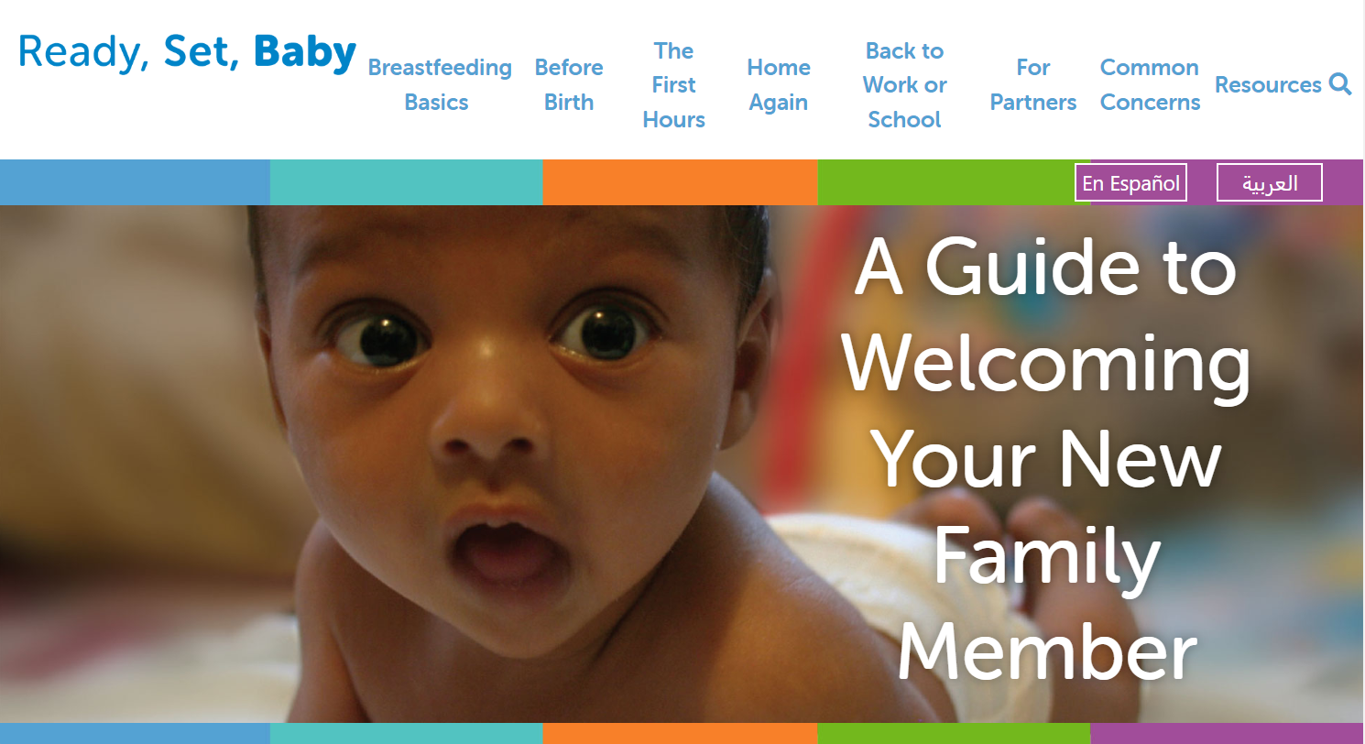
3. Education & Professional Development
For Families
Prospective families are told about breast/chest feeding policy and practice
Enrolled families are regularly offered education
Notes:
Families should regularly receive information about the specific Breast/chestfeeding policies and practices followed by your child care program. This helps remind them of the support you are offering and helps normalize the practice and experience of human milk feeding for all families. Resources to support family education such as Ready, Set, Baby! are available in the resources section at the end.

Slide 8
4. Breast/chest feeding Policy
A comprehensive policy should include:
s
Providing space for families AND staff to feed or express (pump) human milk
Flexible paid or unpaid break times for staff to breastfeed/pump (in compliance with state & federal laws)
Providing refrigerator and/or freezer space to store human milk
Professional development on breast/chest feeding
Educational materials for families/staff on breast/chest feeding
Notes:
Many child care providers recognize the importance of having policies as a tool for educating teachers, staff, and families about how the program operates and what is expected. Without a policy stating expectations for all, families could be subject to the level of breast/chest feeding support of individual teachers or staff members and staff to the level of support and understanding of their supervisor. Sometimes that support can be subjective or biased.
A lactation support policy, like any policy, ensures that every family and employee knows and understands their rights, their roles and their responsibilities. The policy also ensures every employee and family has access to the benefits of the lactation support provided.
Sample policies are available within the Go NAPSACC Tips & Materials section as well as the CT Breastfeeding Friendly Child Care Toolkit, linked in the resources and references at the end of the module.
Many of these important policy topics can be added into your parent handbook. Some may fit better in your staff handbook or human resources manual. As long as the topics are covered they can be located in different places. Your program is still meeting the best practice.

Slide 9
Resources and References
American Academy of Pediatrics Policy Statement: Breastfeeding and the Use of Human Milk: https://doi.org/10.1542/peds.2022-057988
Community breast/chest feeding resources for families searchable by zip code: www.ZipMilk.org
Free online breastfeeding information for families in English, Spanish, Arabic: https://www.readysetbabyonline.com/
CT Breastfeeding Friendly Child Care Toolkits, Recognition Program & Paced Bottle-Feeding resources: https://www.breastfeedingct.org/child-care.html
Continuity of Care in Breastfeeding Support Blueprint. https://www.breastfeedingcontinuityofcare.org
CT Go NAPSACC. Support for implementing Breast/Chest Feeding Best Practices. https://gonapsacc.org/participating-states
Caring for Our Children National Standards. Chapter 4: Nutrition and Food Service. 4.3.1.3: Preparing, Feeding, and Storing Human Milk: https://nrckids.org/CFOC/Database/4.3.1.3
USDA, Food and Nutrition Service. Breastfed Babies Welcome Here. Tools for CACFP providers: https://www.fns.usda.gov/tn/breastfed-babies-welcome-here
For more information on CACFP requirements please visit: https://portal.ct.gov/SDE/Nutrition/CACFP-Child-Care-Centers. Before implementing any changes to your program’s food and nutrition policies or practices, contact your CACFP representative to ensure you are meeting all rules and regulations
Disclosure: The information in this module is based on a variety of sources listed above. It highlights key points relevant to this topic, but is not exhaustive. Please refer to the above resources for more information.
Notes:
These resources support the content covered in this brief module. We encourage you to take a look at them for more information and to share with families in your care.

Slide 10
Thank You!
Made possible with funding from
the Centers for Disease Control and Prevention
Notes:
Thank you for joining us to review Breast/chest feeding Friendly Child Care. This module is made possible by the Centers for Disease Control and Prevention and was developed in collaboration between the UConn Rudd Center for Food Policy and Health and the CT Department of Public Health.

