Slide 1

Food Marketing to Children:
Why should we be concerned?
UCONN Rudd Center for Food Policy and Health
DIGITAL MARKETING
Food Marketing Series: Module 3
Notes:
Parents may not realize just how much food marketing there is, how it influences what they purchase and what their children eat, and just how harmful this marketing can be. In this presentation, we focus on marketing that children and teens see on electronic devices such as computers, smartphones, and tablets – which is also called digital marketing.
.

Slide 2
Most children have poor diets
Notes:
Most children in America eat a poor diet. Nutrition experts say that no more than 10 percent of kids’ food intake should come from empty calories, which are calories from fat and added sugar.

Slide 3
They eat too many high-sugar high-fat foods
Most empty calories in kids’ diets come from:
desserts
pizza
fruit drinks
soda
Notes:
Unfortunately few children meet this recommendation. On average, children in America gets almost half of their calories from nutritionally poor foods, like desserts, pizza, fruit drinks and sugary soda.

Slide 4
And not enough fruits and vegetables
Notes:
Also, few children get the recommended five fruits and vegetables a day. Just four out of ten kids eat enough fruit, and fewer than one out of ten eat enough vegetables.

Slide 5


Poor diet leads to poor health in childhood…
One out of three children is overweight or obese
Type II diabetes used to be called adult onset diabetes.
Now, more than 5,000 youth are diagnosed every year.
Notes:
Eating this way leads to serious health problems. One in three youth is overweight or obese.
So many kids started developing Type 2 diabetes that they had to change the name from “adult onset” diabetes. Today, one in three new cases of diabetes diagnosed in youth 10 to 19 years old are Type 2.

Slide 6

And lifelong consequences
Heart disease
Cancer
Strokes
Arthritis
Life-long obesity
Notes:
Health issues due to poor diet can follow children throughout their lives, often leading to heart disease, cancer, strokes, arthritis, kidney disease, and a lifetime of obesity and its associated health problems.

Slide 7
This may be the first generation of children to live SHORTER LIVES than their parents
Notes:
For the first time in history, we are raising a generation of children that is expected to live shorter lives than their parents.

Slide 8
So where does
marketing
fit into kids’ diets?
Notes:
So how does food marketing affect a child’s diet?

Slide 9
The truth about food marketing
<1% fruits &vegetables
9% other foods
$1.8 billion
Spent per year on marketing aimed at children & teens
40% fast food
51% sugary drinks, sugary
cereals, sweets & snacks
Notes:
The food industry spends a massive amount of money—almost 2 billion dollars—to get kids to eat and drink more sugary drinks, sugary cereals, sweet and salty snacks, and fast food. Less than 1 out of every 100 food marketing dollars is spent on healthy foods like fruits and vegetables.

Slide 10


The newest trend in food marketing to children and teens
Digital marketing
Images courtesy of nenetus at FreeDigitalPhotos.net
Notes:
You probably know about many ways that food companies market to kids – like TV advertising and cartoon characters on product packaging.
But most parents don’t know much about how food companies use digital marketing to reach their kids.

Slide 11



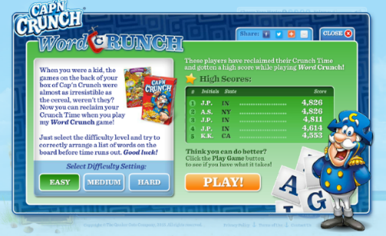
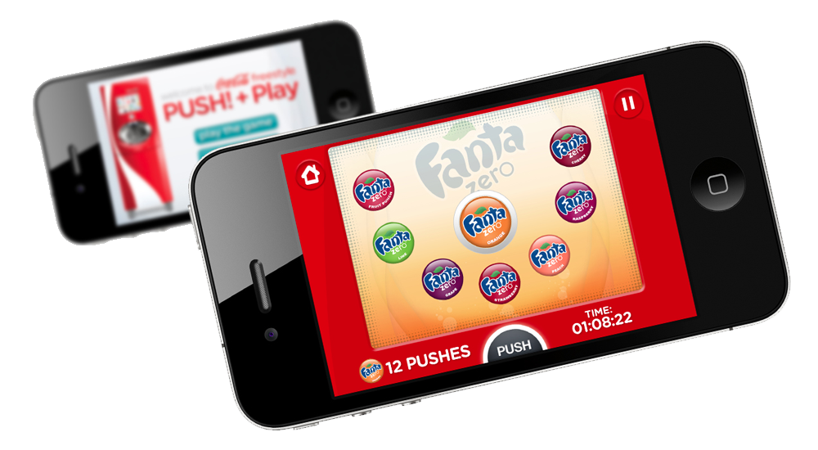
What is digital marketing?
Any type of marketing on…
computers
internet
mobile phones
tablets
game consoles
Notes:
Digital marketing is marketing on electronic devices such as computers, smartphones, and tablets, including in social media.
This type of marketing has become very common-especially for companies that want to appeal to a young audience.

Slide 12
How do food companies reach kids online and on their mobile devices?
Notes:
As kids spend more and more time online and on their mobile phones, food companies have come up with new and innovative ways to reach them any time and anywhere.

Slide 13
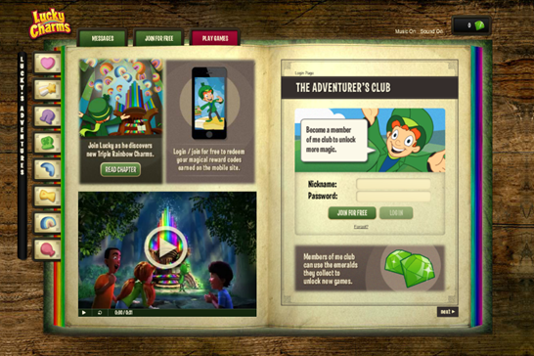
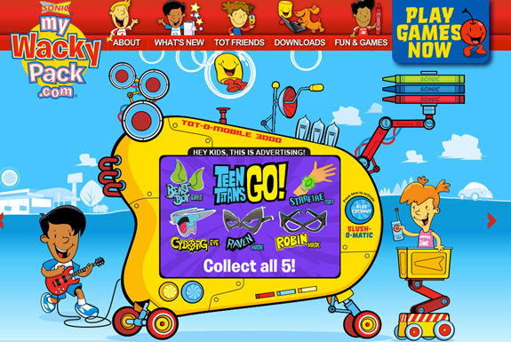

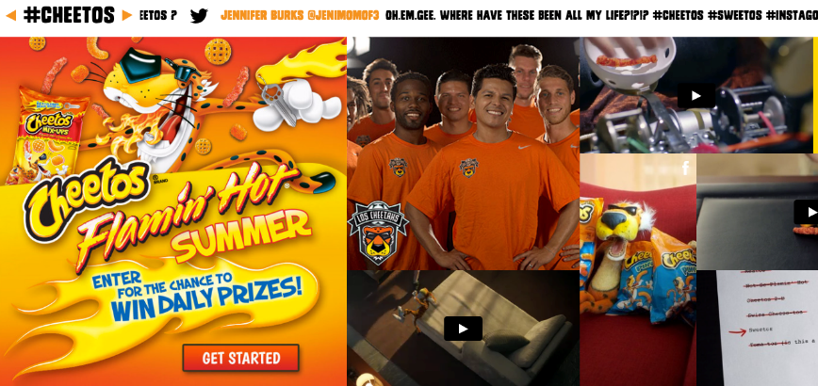
Food company websites
Notes:
For example, they have fun interactive websites that are all about their brands.

Slide 14
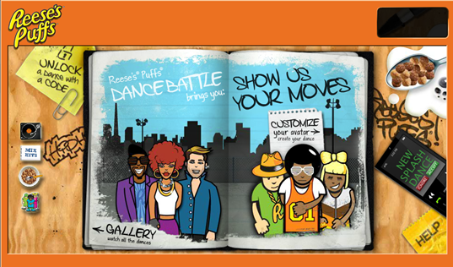

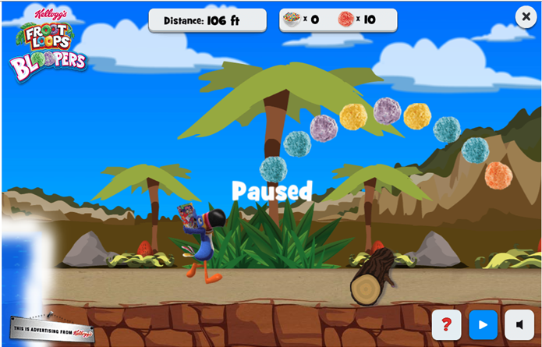
Advergames
Notes:
Most of these websites contain advertising disguised as fun games so children stay on the site and interact with the advertising for as long as possible. Children spend almost 5 minutes on some of these sites each time they visit – that’s as much time as 10 30-second TV commercials.

Slide 15


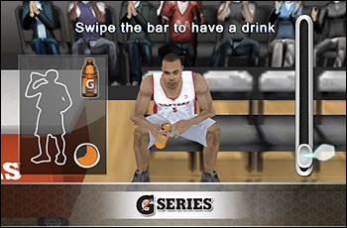
Video game placements
Image courtesy of Ambro at FreeDigitalPhotos.net
Notes:
Some brands, such as Doritos, Pepsi and Mountain Dew, use popular video games as a way to reach kids.
For example, Gatorade placed its brand in this NBA basketball game in a clever way. The game shows a Gatorade Thirst Meter. When a player gets tired or dehydrated, the gamer can give the player some Gatorade to improve the player’s performance. You may wonder if these kinds of product placements work. Gatorade found that it did increase sales.

Slide 16
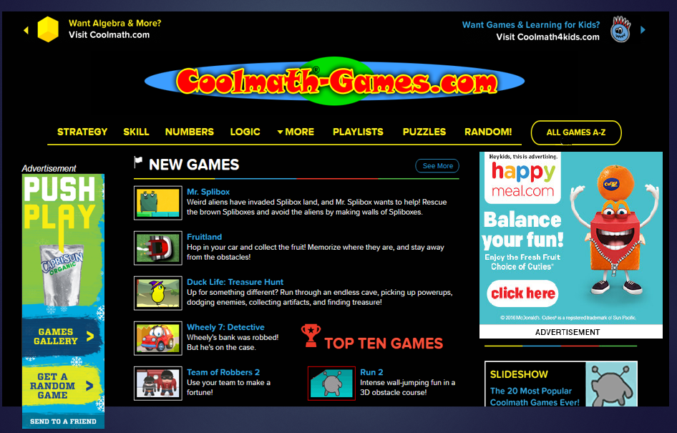




Banner ads on kids’ websites
Notes:
When children visit other popular websites such as nick.com they see a lot of food advertising. Food companies place eye-catching ads on these sites, called “banner” or “display” ads. These ads often include games and links to food company advergame sites.
More than 3 billion food ads appear on children’s websites in a year, and 8 out of 10 of these ads are for unhealthy foods such as fast food and sugary cereals.
Even educational websites have ads for foods. So while children are practicing math on a site like coolmathgames.com, fun and appealing food ads with links to online games pop up on the screen—luring kids from math games to junk food games.

Slide 17
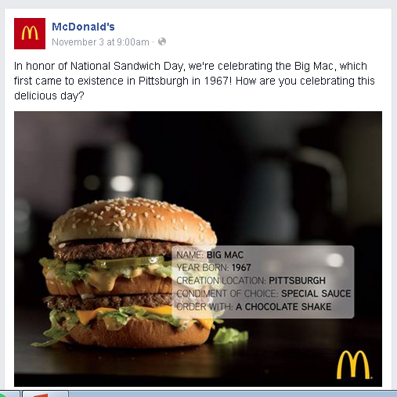
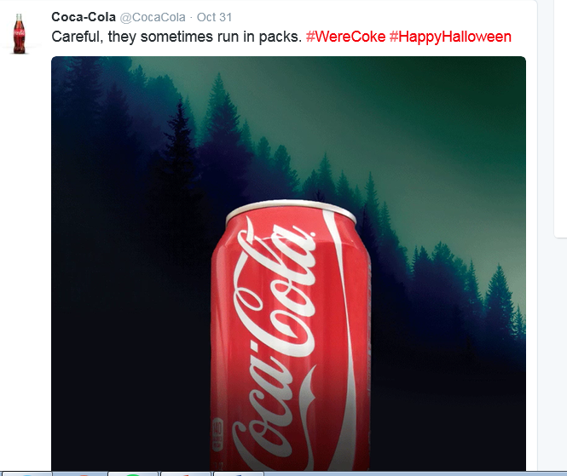
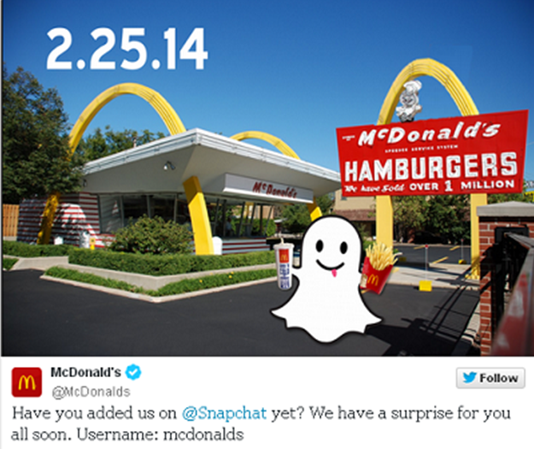
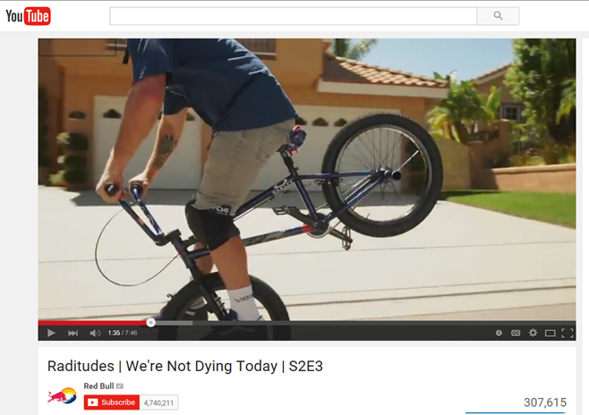
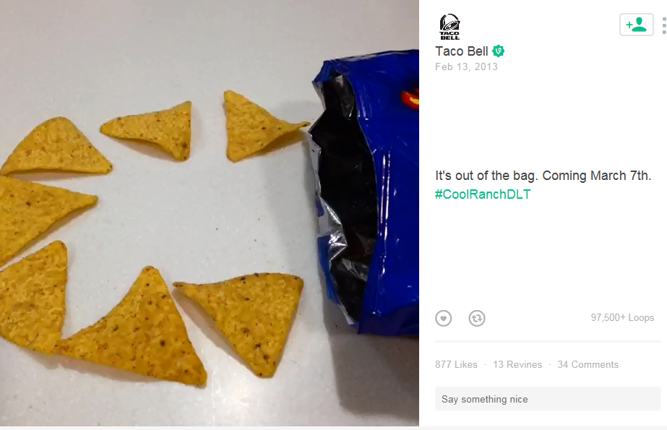
Viral marketing on social media
Twitter
Snapchat
Facebook
Vine
Instagram
YouTube
Notes:
Many companies also advertise to children and teens on popular social media sites, like Facebook, Twitter, Snapchat, Vine ,Instagram, and YouTube.
Food companies have their own social media accounts that kids can like or follow. When kids like a brand, they start to receive posts from the brand. They can share those posts just like they would posts from friends or favorite sports or music celebrities. So then their friends get the posts too, and they see that their friend likes the product. This type of marketing is very effective because it looks like it’s coming from the child’s friends, not from a company. This is also called viral marketing because kids spread the marketing to each other.

Slide 18





Engaging youth
Often….
166 tweets per day
Even this…
320 tweets per day
In personal ways…
Notes:
When children and teens follow brands on social media, companies reach out to them often…
And with very personal messages.
With posts you may not want your children to see…
What makes social media so different from other types of marketing is that it creates a two-way interaction – a conversation -- that can feel very personal. Companies have dedicated staff to reach out directly to kids. Brands like Red Bull offer a friendly ear, affirmation and an opportunity to promote their product in a way that doesn’t feel at all like advertising.

Slide 19












Targeting kids online
Image courtesy of nenetus and digitalart at FreeDigitalPhotos.net
Notes:
And marketing on social media reaches kids even if they don’t follow brands. Food and sugary drink brands use kids’ profiles and habits on Facebook or Instagram to decide what ads will appear on their social media pages. These brands are among the biggest advertisers on social media.

Slide 20


Coke’s slumping sales
Coke wanted to make a personal connection with teens
“Share a Coke” campaign
  250 popular teen names on bottles
  Shared through social media
    Online celebrities
    Encouraged teens to post too
Success!
Notes:
Here’s an example of how a brand markets in social media. Coca-Cola saw its sales slumping and its research showed that teens viewed Coke as “old-fashioned.” So Coke decided to engage with teens through social media with its Share a Coke campaign.
First, Coke put 250 of the most popular teen names on its bottles.
Then it hired celebrities to post ideas about how to share a Coke on Facebook, YouTube, Vine and Instagram. For example, YouTube star Cameron Dallas has over 10 million followers. He posted videos of his pool party – showing all his friends drinking and sharing bottles of Coke.
Coke also encouraged teens to post their own pictures or videos showing them sharing a Coke.
Coke has boasted how this campaign dramatically increased sales and consumption of Coke by teens.

Slide 21
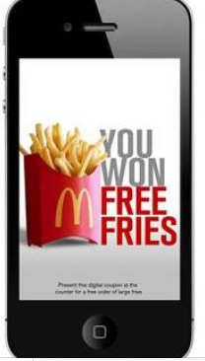
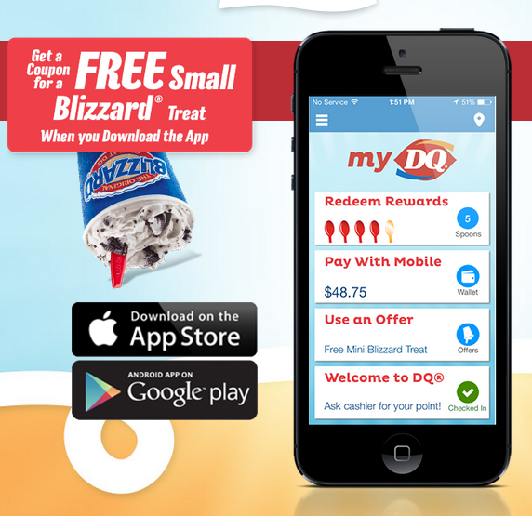

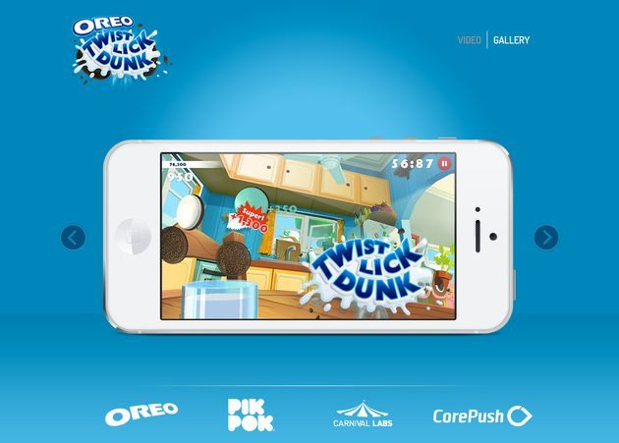
Mobile apps
Notes:
Another way that food companies reach children is on their mobile phones, with fun games and other types of apps. Just like advergames on the internet, this is another way that companies get kids to interact with the advertising for longer periods of time. But since it happens on their mobile phones, now kids can engage with advertising anywhere any time – they don’t have to be sitting at a TV or a computer anymore.

Slide 22

Why should we be concerned?
Photo credit: searchenginewatch.com/sew/how-to/2329883/google-display-ads-on-mobile-devices-how-to-avoid-the-erroneous-clicks-of-children#
Notes:
So, why is all of this something that parents should worry about?

Slide 23
TV time is down, but internet is up
92% of teens go online daily
Even very young children go online daily
  Three out of four children ages 6 to 9
  Two out of four children age 5 and younger
80% of teens have social media profiles
  They spend over 1 hour on social media per day
  Over 7.5 million Facebook users are 12 years old or younger
Notes:
Food companies advertise so much online because that’s where children and teens spend their time now. Even very young children.
And during the time these children and teens are online, they see food advertising, when they watch videos or online TV shows or interact with social media.

Slide 24
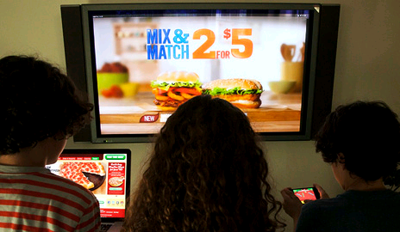
More and more of that screen time is on mobile devices
    Mobile devices account for almost half of the time that teens spend with screens
  Nine out of ten teens access the internet on a mobile phone or tablet
Notes:
And now mobile devices make it almost impossible for parents to know what marketing their children see since it’s not just happening at home anymore. Parents may see the ads their kids are seeing on TV, but parents don’t see what appears on the mobile screens kids carry around with them—all day, every day.

Slide 25
Companies can now market to kids 24/7
Notes:
So companies can now advertise to children around the clock… almost anywhere they spend their time – when parents aren’t looking.

Slide 26
This is advertising in disguise
Children and teens are less likely to recognize digital advertising as a message aimed to influence them
Advertising hidden as something else – like a fun game or a post from a friend – is harder to resist
Viral marketing gets kids to advertise to each other
Notes:
These messages are harder for kids to recognize as advertising.
And when we’re not thinking about it as advertising, it influences us even more.
Especially for younger teens, what their friends like is more important to them than almost anything else.

Slide 27
Is this fair?
“Teens revere the trusted online personalities that they follow in the same way they do the most popular kids in school."
Tim McMullen, founder and CEO of advertising agency redpepper
“Teens are constantly searching for affirmation…a simple social engagement is all it takes to make them feel special.”
Tim McMullen, founder and CEO of advertising agency redpepper
Notes:
Kids share a great deal about themselves online and trust online personalities.
One in 3 teens say they feel more accepted online than they do in real life. So, social media gives companies a powerful tool to take advantage of kids’ vulnerabilities.

Slide 28
What can YOU do to reduce unhealthy food and beverage digital marketing to children and teens?
Notes:
So what can YOU do to reduce unhealthy food and beverage digital marketing to children? There are ways to reduce the influence of unhealthy food marketing in your home, raise awareness, and join with others.

Slide 29

In your home
Talk
to your kids. Understand how they are
using digital devices
Explain what advertisers are trying to do
using digital media
Notes:
Talk to your kids about what marketers are trying to do. When your child asks for an advertised food, explain why you don’t want to buy it, and how the advertiser has spent a lot of money trying to convince your child that they must have this food.
Explain to your teens that if they post pictures of brands of food or beverages they are providing free advertising for companies. Companies encourage kids and teens to do this—getting teens to advertise to other teens for free.
Also, while it may appear that online celebrities who post brands are just showing a part of their lives or being creative, they are usually getting paid a lot of money by companies to post those pictures and videos. What seems funny and creative is just an ad in disguise.

Slide 30


In your home
  Use parental controls on smartphones and tablets. Controls help set limits and monitor mobile device use
  Limit screen time. Experts recommend no more than 2 hours per day, including computers and mobile devices
  Turn off cell phones. Keep them out of the bedroom and turn them off during meals and at bedtime
Images courtesy of yingyo and Clare Bloomfield at FreeDigitalPhotos.net
Notes:
Use parental controls on devices.
Limit screen time – experts recommend no more than 2 hours total per day
Remove all screens from your kids’ bedrooms. Smartphones should be put away at bedtime—probably best left in another room to avoid temptation. This can help increase your child’s time for reading and sleeping.

Slide 31



Want to do even more?
Learn more about unhealthy food marketing to kids.
Visit www.uconnruddcenter.org/food-marketing
Get Rudd Center news and updates on social media:
Join the Food Marketing Workgroup:
Network of 200+ organizations, individuals, and experts dedicated to eliminating harmful food marketing.
Visit www.foodmarketing.org
Notes:
For more information about unhealthy food marketing to kids, visit www.uconnruddcenter .org, or stay in touch through our social media channels.
You can also join the food marketing workgroup, a nationwide network of organizations, individuals and experts dedicated to eliminating harmful food marketing. Visit www.foodmarketing.org.

Slide 32
In your community
Local Presenters: Use this slide to describe any local campaigns or initiatives that people can join to make a difference in their local communities
If you don’t have any such initiatives at present, feel free to delete this slide.
For ideas about local campaigns, visit our contact page at www.uconnruddcenter.org
Notes:
Emphasize raising awareness and the importance of sharing what you’ve learned with others.

Slide 33
Check out the following sites for more information.
Common Sense Media
www.commonsensemedia.org
Center for Digital Democracy www.democraticmedia.org
Campaign for a Commercial Free Childhood www.commercialfreechildhood.org
Notes:
Check out these websites for more ideas about what you can do to protect your children from unwanted marketing in digital media.

Slide 34

Thank you!
www.UConnRuddCenter.org

