Slide 1
Food Marketing to Children: Why should we be concerned?
UConn Rudd Center for Food Policy and Health
Marketing in Schools
Food Marketing Series: Module 2
Notes:
Parents may not realize just how much food marketing there is, how it influences what they purchase and what their children want to eat, and just how harmful this marketing can be. In this presentation, we focus on the marketing children see in schools.

Slide 2
Most children have poor diets
Notes:
Most children in America eat a poor diet. Nutrition experts say that no more than 10 percent of kids’ food intake should come from empty calories, which are calories from fat and added sugar.

Slide 3
Too many high-sugar high-fat foods
Most empty calories in kids’ diets come from:
desserts
pizza
fruit drinks
soda
Notes:
Unfortunately few children meet this recommendation. On average, children in America get almost half of their calories from nutritionally poor foods, like desserts, pizza, fruit drinks and sugary soda.

Slide 4
And not enough fruits and vegetables
Notes:
Also, few children get the recommended five fruits and vegetables a day. Just four out of ten kids eat enough fruit, and fewer than one in ten eat enough vegetables.

Slide 5
Poor diet leads to poor health in childhood…
One out of three children is overweight or obese
Type II diabetes used to be called adult onset diabetes.
Now, more than 5,000 youth are diagnosed every year.
Notes:
Eating this way leads to serious health problems. One in three children and teens is overweight or obese.
So many kids started developing Type 2 diabetes that they had to change the name from “adult onset” diabetes. Today, one in three new cases of diabetes diagnosed in youth 10 to 19 years old are Type 2.

Slide 6
Poor diet has lifelong consequences
Heart disease
Cancer
Strokes
Arthritis
Life-long obesity
Notes:
Health issues due to poor diet can follow children throughout their lives, often leading to heart disease, cancer, strokes, arthritis, kidney disease, and a lifetime of obesity and its associated health problems.

Slide 7
This may be the first generation of children to live SHORTER LIVES than their parents
Notes:
For the first time in history, we are raising a generation of children that is expected to live shorter lives than their parents.

Slide 8
What, and how, kids eat clearly needs to change.
Notes:
What, and how, kids eat clearly needs to change.

Slide 9
So where does
marketing
fit into kids’ diets?
Notes:
So how does food marketing affect a child’s diet?

Slide 10
The truth about food marketing
<1% fruits &vegetables
9% other foods
$1.8 billion
Spent per year on marketing aimed at children & teens
40% fast food
51% sugary drinks, sugary
cereals, sweets & snacks
Notes:
The food industry spends a massive amount of money—almost 2 billion dollars a year—to get kids to eat and drink more sugary drinks, sugary cereals, sweet and salty snacks, and fast food. Less than 1 out of every 100 food marketing dollars is spent on healthy foods like fruits and vegetables to kids.

Slide 11
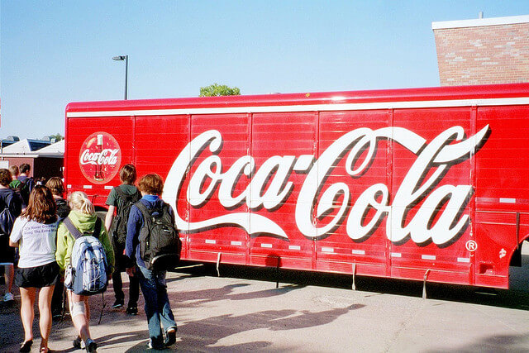
What about food marketing to kids in school?
Do unhealthy brands belong in a place of learning?
Credit: Zac Zellers
Notes:
When we send our children to school, we expect them to learn about math, reading, and science, etc. But food companies are also trying to teach them about their brands. Marketing soda, candy, fast food and other unhealthy products in schools undermines efforts to teach children about good health and nutrition.
So where do kids see food marketing in their schools?

Slide 12
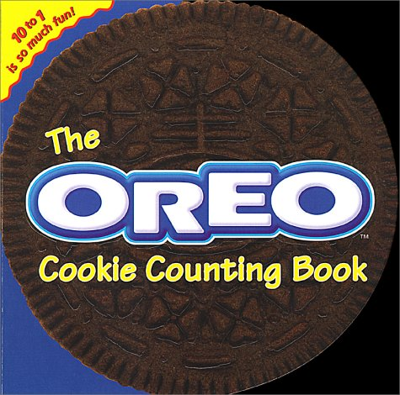
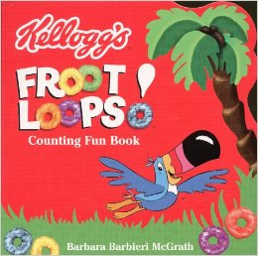
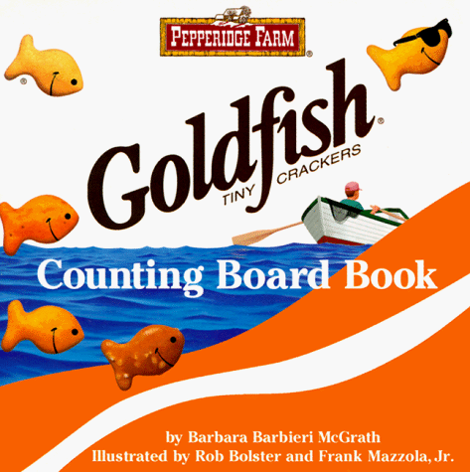
Helping kids with math?
Notes:
Food and beverage companies donate so-called “educational” materials and incentives like coupons to teachers free of charge because they know that the more often students see or hear their brand names and logos, the more kids will like their brands.
And because the materials are free, lower income schools use them more often.

Slide 13
Encouraging kids to read?

Slide 14
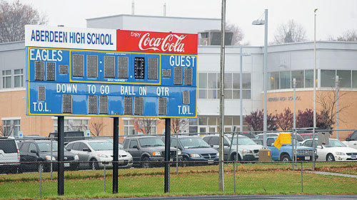
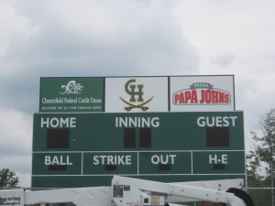
Sponsoring sports and other extracurricular activities?
Notes:
What does it teach kids when the products featured in the halls, cafeterias, vending machines and athletic fields are the same ones that their teachers and parents tell them are not good for their health?

Slide 15
Why do food companies target kids at school?

Slide 16
Kids are a captive audience
Credit: Stacey Tucker
Notes:
They provide a captive audience of 30 million students in elementary, middle and high schools around the country.
And schools are one place where parents cannot monitor and control the messages their children see.

Slide 17
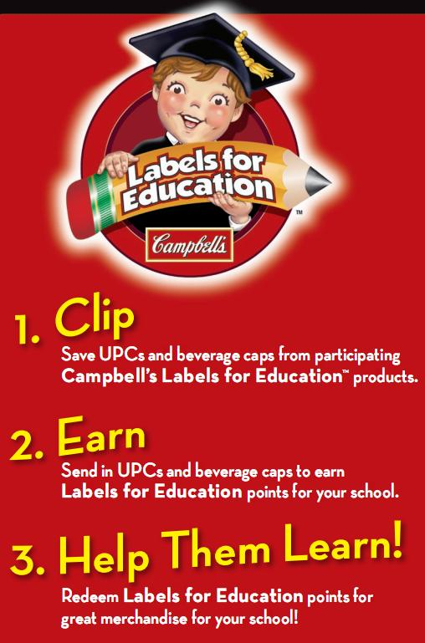
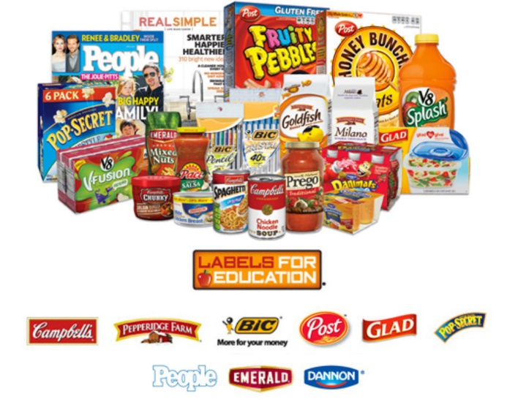
It’s great public relations
Notes:
These so-called educational and charitable programs create positive feelings about the companies. Most schools and parents view them as a public service. When in fact, companies see them as a very inexpensive and effective way to market their products to children and teens.

Slide 18
Schools and teachers endorse their brands
Notes:
Marketing in schools implies that the school and teachers endorse or approve of these products. This sends a mixed message to students.

Slide 19
It leads to lifelong loyal customers
“It isn’t enough to just advertise on television… You’ve got to reach kids throughout their day – in school, as they’re shopping at the mall… or the movies. You’ve got to become part of the fabric of their lives.”
- Carol Herman, Senior Vice President, Grey Advertising
They aren’t children so much as what I
like to call ‘evolving consumers.’”
- CEO of Prism Communications
Notes:
Most importantly, marketing in schools is a very effective tool in companies’ efforts to create lifelong loyal customers.

Slide 20
So how much marketing goes on in schools?
Notes:
So how much marketing goes on in schools?

Slide 21
According to the Federal Trade Commission…
$149 million: the amount food companies spend on marketing in schools in one year
93%: the percent of that marketing spent on drinks – mostly regular soda
19 grams: the amount of sugar in drinks marketed to children under 12 in schools
Notes:
The Federal Trade Commission did a study and found that:
Food and beverage companies spend almost $150 million to market to children and teens in their schools.
More than 9 out of 10 of those dollars is spent to market sugary drinks, especially soda
Those sugary drinks have almost 5 teaspoons of sugar per serving!

Slide 22
In 2 out of 3 elementary schools, food companies offer coupons to children as rewards
3 in 10 high schools serve branded fast food every week
2 in 10 serve branded fast food every day
7 out of 10 elementary and middle school students see food marketing in their schools every day
Notes:
That means that a lot of children see a lot of marketing in their schools

Slide 23
Is this happening in YOUR child’s school?
Notes:
Do you think this might be happening in your child’s school? Here’s what to look for..

Slide 25
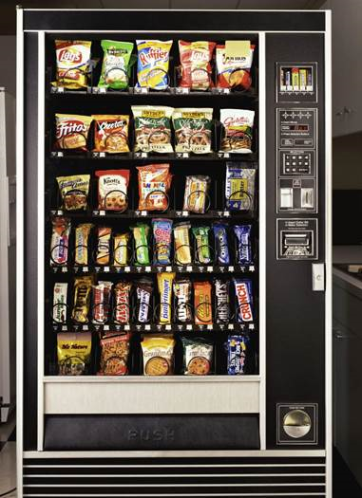
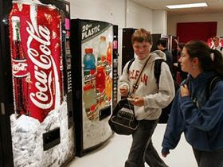
Branded food and beverage sales
Notes:
Have you seen this in your child’s school?

Slide 26
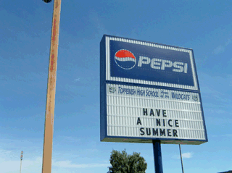
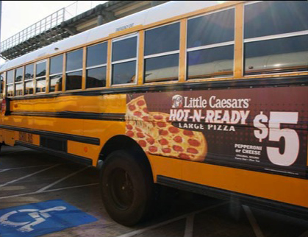
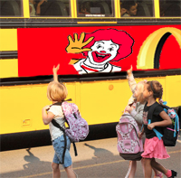
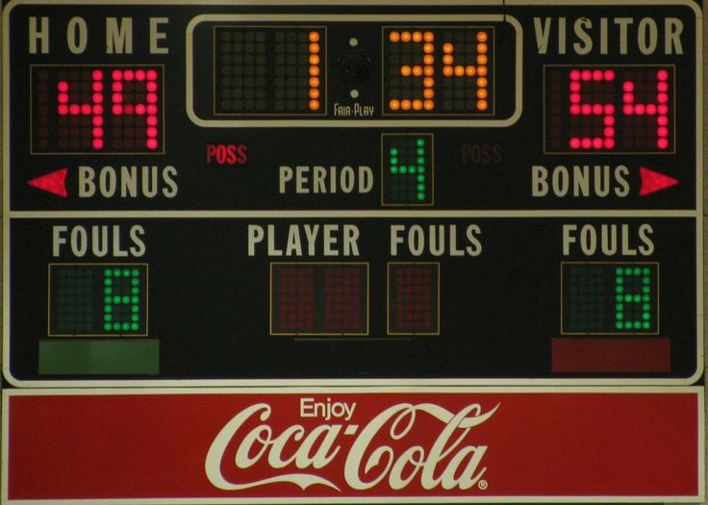
Ads on school property
Notes:
Or any of these?

Slide 27
Marketing in the classroom
Notes:
Your kids might be seeing these
Websites and TV channels for teachers with ads for kids
Even book covers

Slide 28
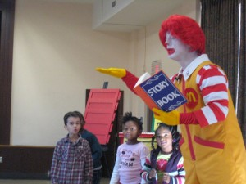
Marketing disguised as philanthropy

Slide 29
Branded food fundraisers
Notes:
You’ve probably seen these
It can be very confusing to children to learn about what and how they should eat in health and nutrition classes, only to turn around and find that their schools are promoting sugary, non-nutritious foods through things like fundraisers. These kinds of double messages undermine the health lessons kids learn in the classroom.

Slide 30
But don’t schools need the money?
Two out of three branded fundraisers raise no money at all for schools
Vending machines provide just $2 to $4 per student per year
At McTeacher’s Nights, schools get as little as $1 per student
Notes:
Well it turns out that a lot of times they don’t get much.
The examples here show how little revenue schools get from this type of marketing, and the companies make out MUCH better in the deal. Thus, they’re getting credit for doing good, reaping the benefits, and making our children sick in the process.

Slide 31
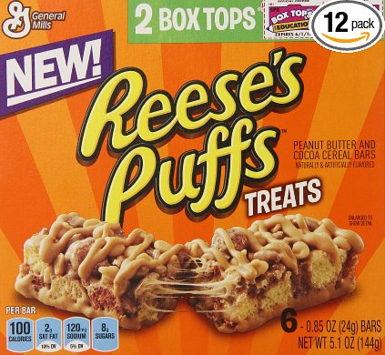
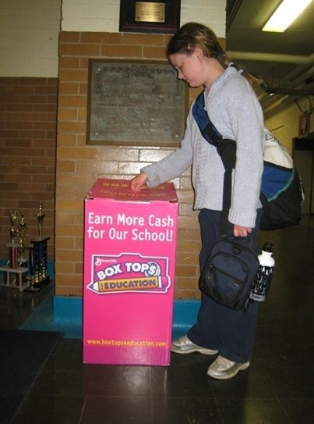
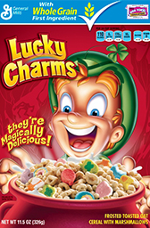
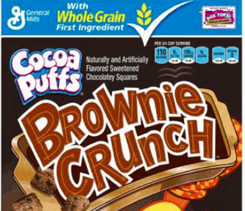
Box Tops for Education
Notes:
You may know about Box Tops for Education.
But did you know that a school gets just 10 cents for each “top”? That means that if parents buy 50 boxes of Lucky Charms – more than 150 dollars – the school only gets 5 dollars.

Slide 32
What do parents think?
2 out of 3 parents support limits on marketing in schools
Most school officials also support limits
Over 7 out of 10 parents support setting nutrition standards for foods sold for fundraising
Notes:
You might think that you’re the only parent that doesn’t want companies marketing unhealthy foods to children in schools. But most parents feel that way.

Slide 33
It doesn’t have to be this way!
What about HEALTHY fundraising?
Notes:
There is a better way. What about healthy fundraising?
Here are just a few examples

Slide 34
CHANGES are starting to happen….
Maine and Nevada have laws about marketing unhealthy foods in all public schools
Local schools districts, like San Francisco, are setting policies to get rid of food marketing in schools
Notes:
Some states have passed laws about food marketing in schools
And local schools districts can set guidelines to limit food marketing in schools in their school wellness policies

Slide 35
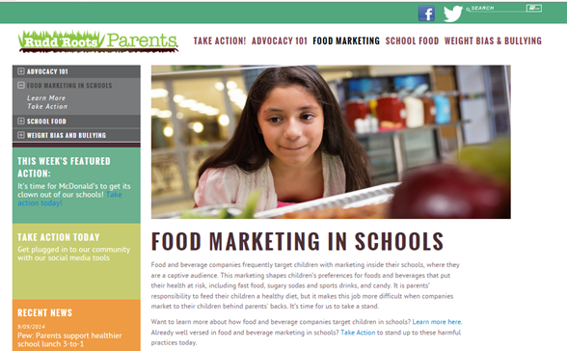
YOU can help! Are you on board?
For more ideas and resources, visit RuddRootsParents.org

Slide 36
Thank you!
www.UConnRuddCenter.org
Notes:
http://www.ruddrootsparents.org/food-marketing-in-schools/take-action/assess-your-school

